Slide 1
AMAC TechMatch
Technology Essentials for College Students

Slide 2
Assistive Tech: A Closer Look
Review AMAC TechMatch Service
Review AT Tools and Features
Reading
Writing & Note Taking
Demonstrations / Discussion
Using Features and Tools
Consideration Related to Their Use
2 /26

Slide 3
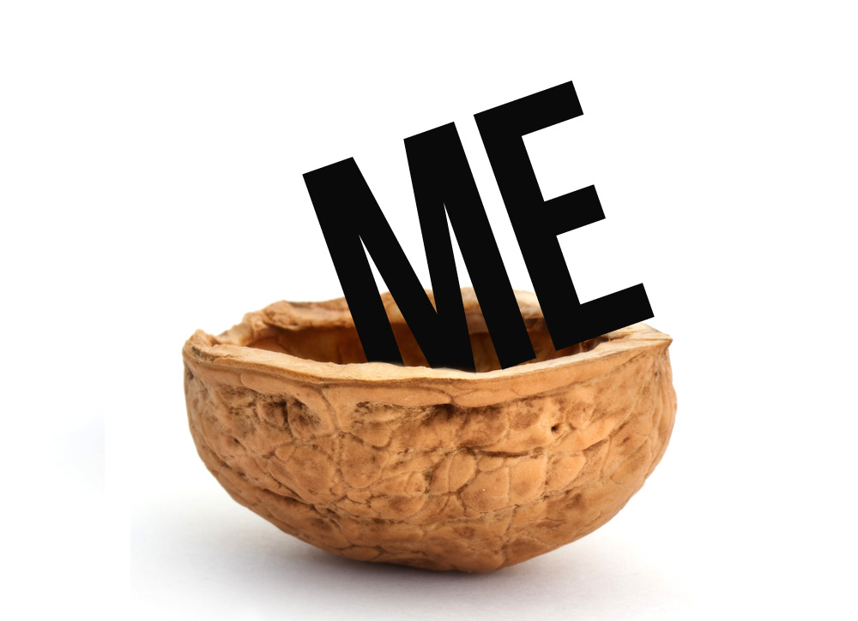
Introductions
Joe Tedesco. M.Ed., ATP
TechMatch / Assessment Services, Manager
ATP, Assistive Technology Practitioner
Assessment, Private, Schools, VR
3 /26

Slide 4
Training ● Experience ● Knowledge
Principals of Assistive Technology
Training: University of Miami, Miller School of Medicine:
Module 1: Introduction to Assistive Technology
Module 2: Assessment for Assistive Technology
Module 3: Laws Pertaining to Assistive Technology Service Delivery
Module 4: Assessment for and Use of Assistive Technology-Hearing/Vision/Communication
Module 5: Assessment for and Use of Assistive Technology-Motor Skills
4 /26

Slide 5
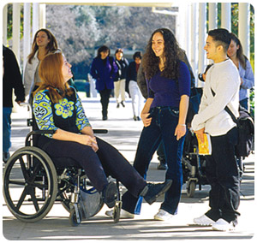
Training ● Experience ● Knowledge
Certification
Rehabilitation Engineering and Assistive Technology Society of North America RESNA,
http://resna.org/
Aspects of disAbilities
Understanding of Psychological and Physical Development
Knowledge of disabilities
Helps to specialize
5 /26

Slide 6
AMAC

Slide 7
AMAC Accessibility Services
Accessible Education/Information
BOR GA; lower cost, increase accessibility
Affect the Environment
Membership;
Post Secondary
CGN
AT Individual
7 /26

Slide 8
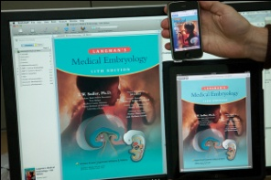
AMAC Accessibility Services
Services & Products
Accommodations
Electronic Text Production; Audio and eText
Braille
Captioning / Transcripts ; Live and Asynchronous
Training, Technical Support
Transcription / Remote Captioning
SAM; Student Accommodation Manager
AccessIT
Faculty / Curriculum Services (in development)
AND….
8 /26

Slide 9
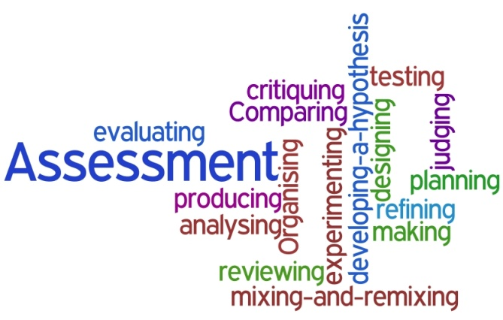
TechMatch
AMAC AT Assessment TechMatch
Independent
UGA RCLD
GA Tools for Life
Goal:
Best Practice – Build Capacity – Build Community
9 /26

Slide 10
The Process
Getting the Core Information
Understand the Practical Effect
Personal Goals
Discussion / Consultation
ENTER ‘The Intake’
10 /26

Slide 11
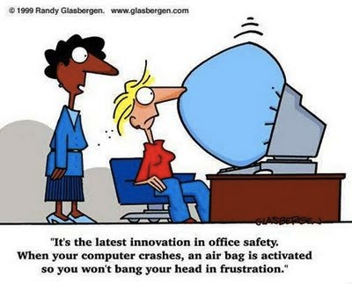
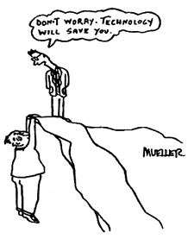
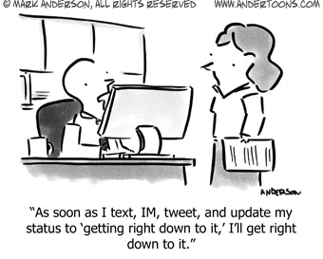
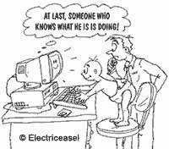
The Technology
SO MUCH…and more everyday!
11 /26

Slide 12
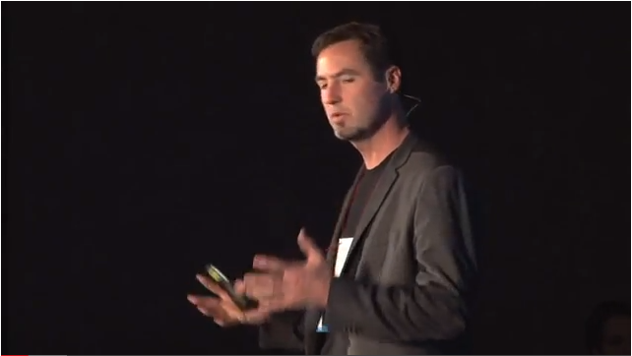
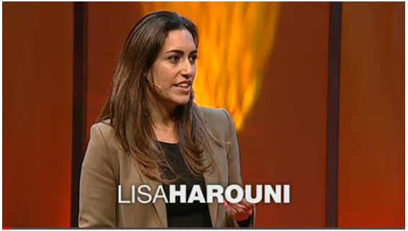
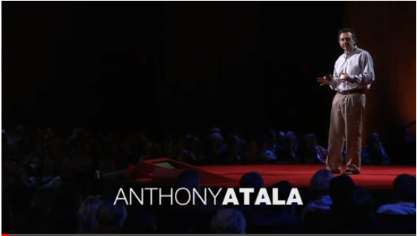
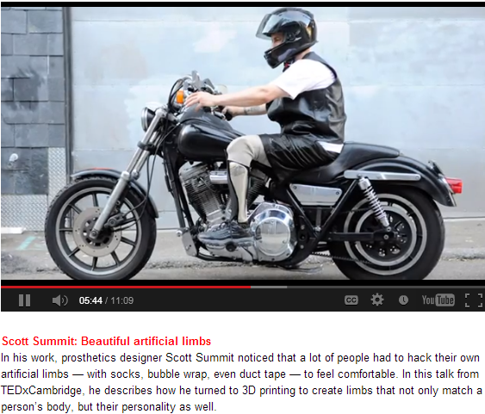
The Technology
SO MUCH…and more everyday!
3D Printing – Pens to Kidneys
Blow your mind design….
12 /26

Slide 13
Assistive Technology
Actual Technology Related: turns on and off, uses electricity, etc.
High Tech Stuff
Continues to Grow and Expand (Mainstreamenized!)
Low Tech Stuff
BUT don’t forget….
13 /26

Slide 14
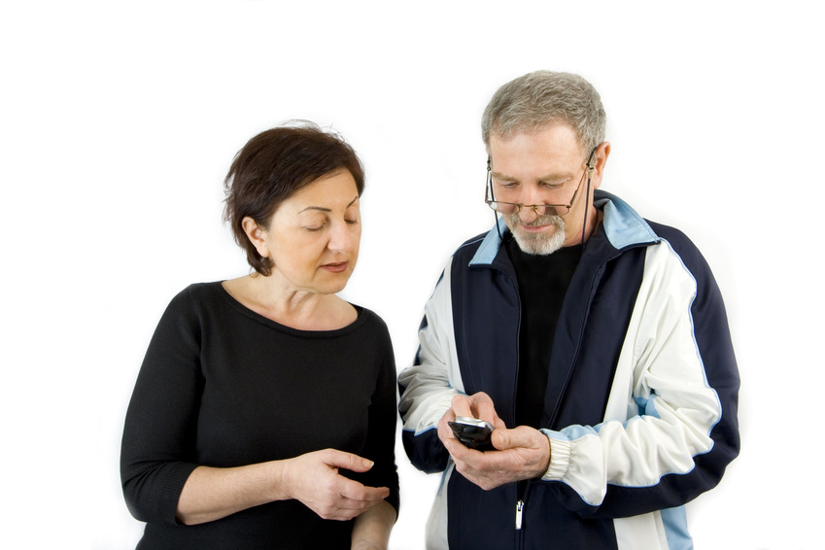
Assistive Technology
Services and Resources
Assessment
Training
Demonstration
Websites forums / resources / videos
Web hosted technologies
Manufacturers, Service Providers, etc.
Funding resources
14 /26

Slide 15
The Technology
SO MUCH…and more everyday!
Mainstream / Assistive
Crossroads
Software, Hardware
Apps
Adapt / Build on Tech Skills
Interactive Web Resources
15 /26

Slide 16
The Technology: Features, Tools & Resources
Strategy…FTR!
Rather than ‘only’ name brands
Features
Tools
and
Resources
Oh my!
Let’s Look at Some FTRs for READING
16 /26

Slide 17
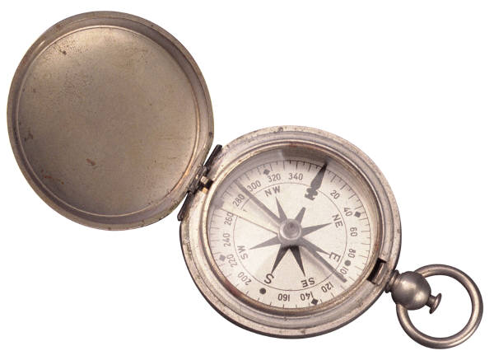
The Process
Information Gathering / Review
Past – Present – Future
Assessing the Information – 91 pages!
Psychoeducational Reports
Some Key Elements (the ah-ha!)
Show’em the list & charts
17 /26

Slide 18
The Psychological
The Psychological Evaluation
Let’s Take a Look…
Cognitive Linguistic Results & Achievement Results
Strengths & Challenges
Starting Point Matching
Sample Psych Report
18 /26

Slide 19
The Match Example
Draft/Brainstorm Report
Orthographic Awareness (speed and accuracy in matching printed number/letters, sensitivity to the details of printed words, and awareness of implicit spelling patterns) reading word recognition
=
Accommodation: Alternative Media ; Books and tests in electronic format
+
Technology: Text to Speech
Reads the text on your computer screen
Color Tracking: highlights words as it reads them
Compatible: Works with multiple File Formats including: Standard Text, MS Word (compatible with .doc and .docx files), HTML and Rich Text Formats.
Cut and Paste “to” or “from” any program.
Reading Options : Adjustable reading speeds plus ability to read one word at a time
Show Test Result Effect on Reading
19 /26

Slide 20
The TechMatch Report
The TechMatch Report
Adjust Based on Consultation with Student
Demonstration
Let’s Take a Look…
Sample TechMatch Report
20 /26

Slide 21
Beyond the Match
Assistive Technology Evaluation Cycle
Assess: Collect / Consider Information
Match Technology
Training
Trial
Feedback
Return to 1
Assess
Match
Train
Try
Feedback
21 /26

Slide 22
Let’s Take a Look: How It Come Together
Disability / Ability
Technology
Activity:
Reading and Writing
How it all comes together
22 /26

Slide 23
Technology Support for…
Reading
Writing
Note Taking
Math
Studying
Organizing
AMAC Stuff
TFL App Database
Tech Matrix
23 /26

Slide 24
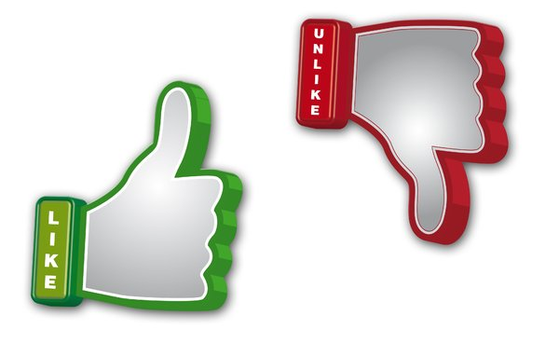
Let’s Consider
Reading
Traditional Compared to Text-to-Speech
Writing
Typing/ Hand Writing compared to Voice- to-Text
Note Taking compared to
Note Taker
Smart Pen
24 /26

Slide 25
Questions?
25 /26

Slide 26
TechMatch Service
What we do….
Review of tests and reports: Psychological testing, IEP, work plans, medical and therapy Reports, etc.
Technology Consultation: Discussion of goals, strengths & challenges of the student and their environment.
AT Exploration: Demonstration of technology tools.
Provide Comprehensive Report
AT Membership: AT Assessment
More Information AMAC Wiki Page
$450 Report
26 /26

Slide 27
THANK YOU!!
For more information:
Joe Tedesco
joe.tedesco@amac.gatech.edu
For more information about AMAC services:
amacsales@amac.gatech.edu
AMAC is an initiative of the Board of Regents University System of Georgia and is committed to removing barriers for individuals with disabilities by improving the human condition through technology in academic and workplace environments.
27 /26

