Slide 1

Pass It On: Expanding the Outreach of Assistive Technology
Carolyn Phillips & Liz Persaud
Pass It On Center
AMAC | Georgia Tech www.passitoncenter.org
Successful Strategies, Innovative Partnerships, Futures Planning

Slide 2

Your National Pass It On Center (PIOC)
Assistive Technology (AT) Reuse continues to grow as a national priority. Over 220 AT Reuse programs have been established to assist people with disabilities, their families, and circles of support to exchange or refurbish AT that they no longer use. Other individuals that lack insurance or don’t qualify for traditional funding solutions are seeking affordable, used assistive technology, including durable medical equipment, to meet their needs. Pass It On Center is working with an established network of AT Reuse Programs to discover promising practices, define indicators of quality and promote safe and effective reuse of equipment.

Slide 3
Learning Objectives
1. First Key Learning Objective At the end of this session, participants will be able to identify and define the 4 types of AT Reuse.
2. Second Key Learning Objective At the end of this session, participants will learn 3 resources to establish an AT Reuse network in their community.
3. Third Key Learning Objective At the end of this session, participants will know how to access resources, as well as local reuse programs, through the Pass It On Center website.

Slide 4
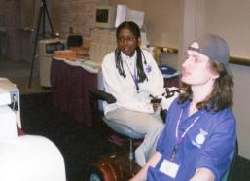
Marketing Diagram
We are Here to Help!
Pass It On Center: Who we are, what we do
Knowledge Base
Indicators of Quality for AT Reuse
State Summits & onsite TA to Grow AT Reuse Collaborations
Webinars
National AT Reuse Conference in Washington, DC in September 2015!
TEXT
TET
TEXT
TEXT

Slide 5

Marketing Diagram
How Can We Help You?
What Webinars do You need?
What types of sessions/topics do you need us to cover at the National AT Reuse Conference in Washington, DC in September 2015?
TEXT
TET
TEXT
TEXT

Slide 6
Why Reuse AT?
Assistive Technology (AT) reutilization is a concept that was born out of need.
From local grassroots efforts, it has grown to become a nationally recognized response to providing AT to those people who would otherwise “go without”.

Slide 7
What is Assistive Technology (AT)?
ASSISTIVE TECHNOLOGY DEVICE - The term `assistive technology device' means any item, piece of equipment, or product system, whether acquired commercially, modified, or customized, that is used to increase, maintain, or improve functional capabilities of individuals with disabilities.
This includes, but is broader than, durable medical equipment (DME).

Slide 8

The Pass It On Center has created national and state resources to foster the appropriate reuse of AT so that people with disabilities can get the affordable AT they need in order to live, learn, work and play more independently.

Slide 9
Goal of Reuse Initiative
To increase the availability of assistive technology (AT) through promoting and supporting the appropriate, effective reuse of AT devices at the state and local level.
Notes:
OSERS Overview
2/5/2015
9

Slide 10
What Is ‘Appropriate’ Reuse?
Appropriate reuse:
Is safe for consumers and reusers
Results in positive outcomes for consumers
Is environmentally friendly
Notes:
OSERS Overview
2/5/2015
10

Slide 11
What Is ‘Effective’ Reuse?
Effective reuse:
Meets the needs of consumers
Produces cost savings
Is sustainable
Has a positive or neutral effect on the AT field
Notes:
OSERS Overview
2/5/2015
11

Slide 12


AT Reuse activities include:
  Device exchange
  Device loan
  Reassignment
  Refurbishment
  Remanufacturing (NO, NO, NO!)
  Recycling

Slide 13
Device exchange:
Matching donors to users without intervention (e.g., “classifieds” and on-line auctions)
Device loan:
Providing a device on loan for some period of time or indefinitely, usually to help user make informed choice or to provide interim solution
Program web sites and E-Bay, Craig’s List,
Newspaper ads, et al.

Slide 14
Reassignment:
Making donated devices available to new users
Refurbishment:
Repairing/restoring donated devices to working order

Slide 15
Remanufacturing – making changes to donated items that alter original manufacturer’s specifications or function
NOT RECOMMENDED!
Recycling – breaking down unusable devices into spare parts or disposing of in an environmentally appropriate manner

Slide 16
What kinds of reuse programs exist?
  Some accept and refurbish durable medical equipment.
  Some accept and refurbish computers and other digital devices.
  Some are dedicated to sharing AT in school settings.
  Some receive donated medical supplies for redistribution.

Slide 17
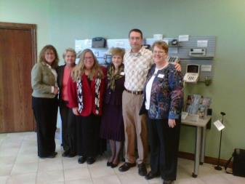
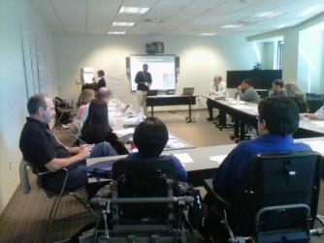
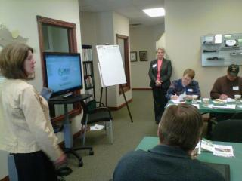
Highlights of Year 5 in Review
Expanding Reuse through Specific Events
State Summits held in 17 states
Notes:
17
Liz

Slide 18
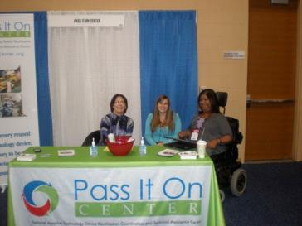

ATIA Pre-Conference and Reuse Strand
Highlights of Year 5 in Review
Expanding Reuse through Specific Events
ATIA Chicago & Orlando 2006 - 2014
  Pre-Conference on How to Start to Start or Improve an AT Reuse Program
  7 session strand on AT Reuse
  Booth in exhibit hall
Notes:
Liz

Slide 19

Learn about reuse.
  Pass It On Center offers resources to promote new programs and to help existing ones improve.
Indicators of Quality (online tool)

Slide 20
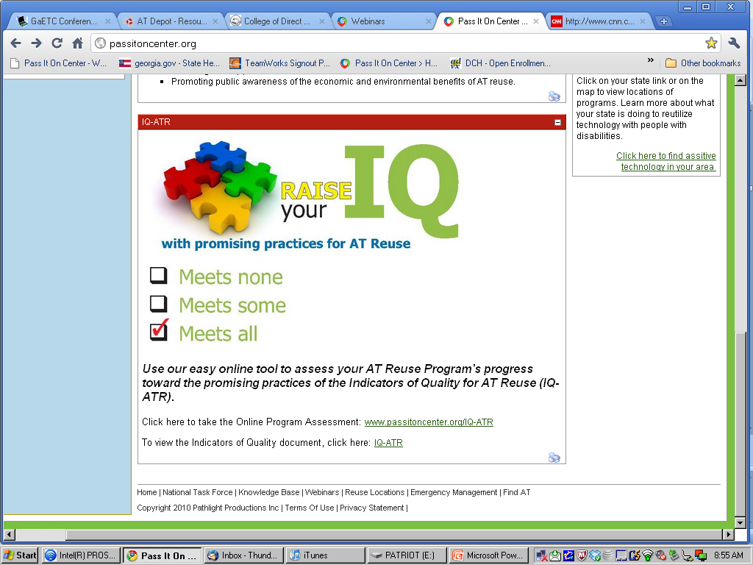
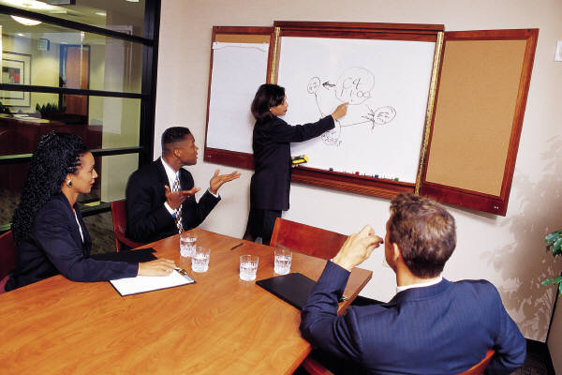
Guiding Principles

Slide 21
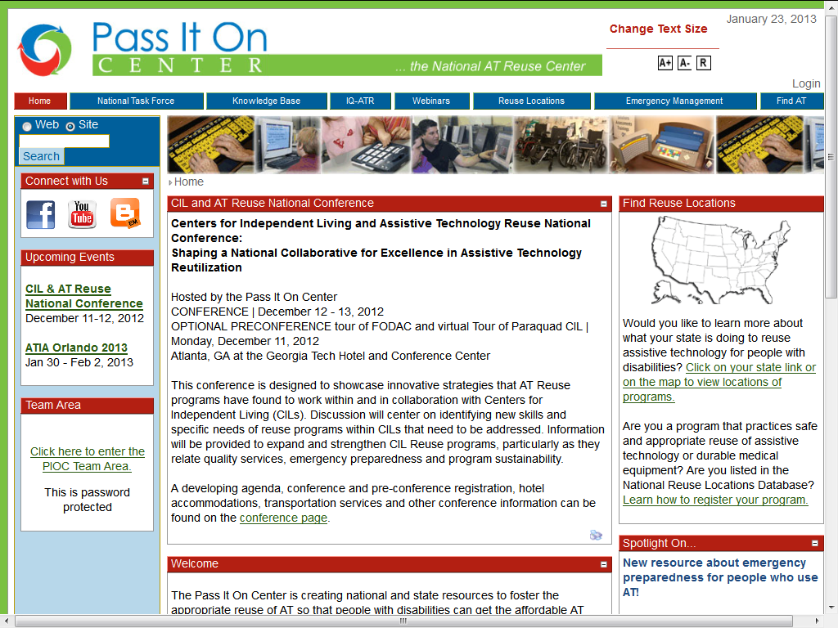

Slide 22
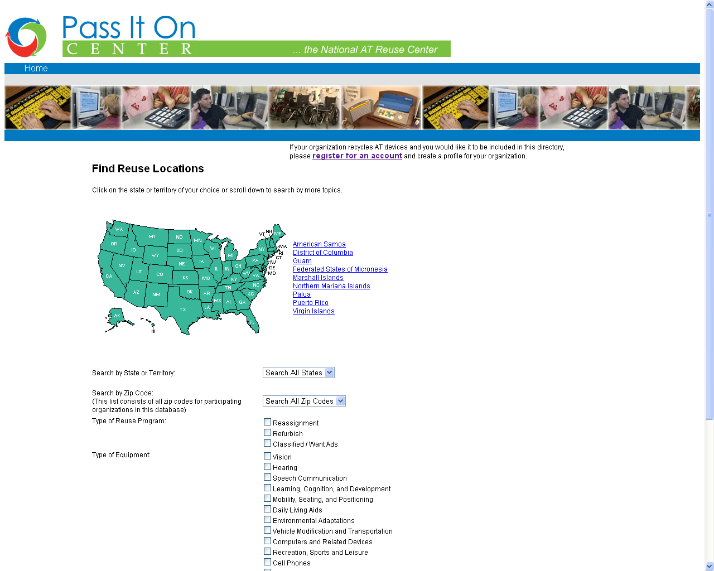

Slide 23
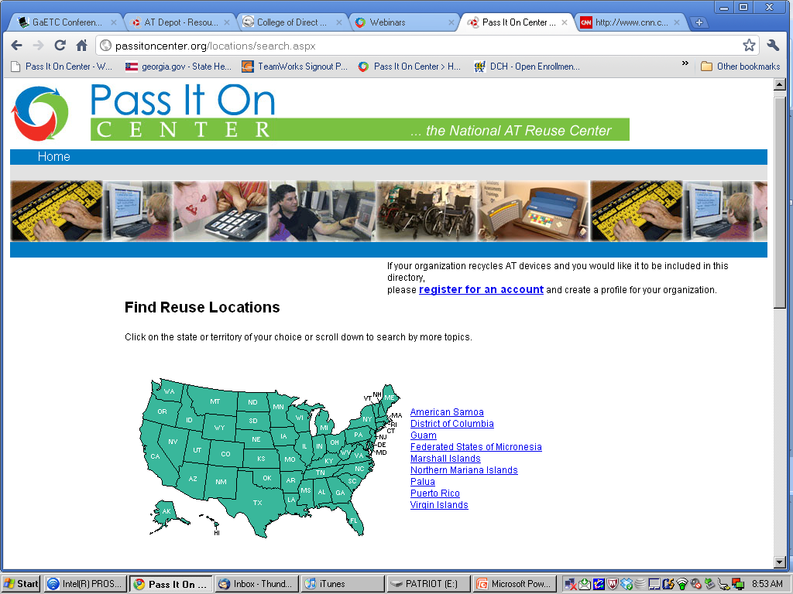

Slide 24
In five years…
As of June 2014, the number of states and programs listed had increased to 222. Of these:
  116 conduct reassignment activities
  87 conduct refurbishment activities
  48 conduct equipment exchange activities
  60 conduct reassignment & refurbishment
  18 conduct reassignment & exchange activities
  15 conduct refurbishment and exchange activities
  12 conduct reassignment, refurbishment & exchange
1 state and 3 territories have no AT reuse listing on the database of AT reuse programs.

Slide 25
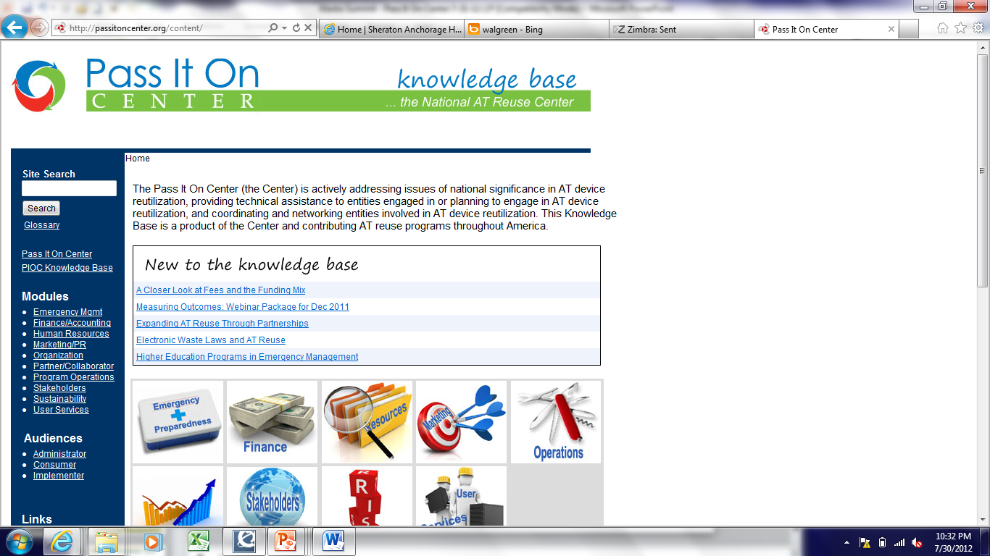

Slide 26
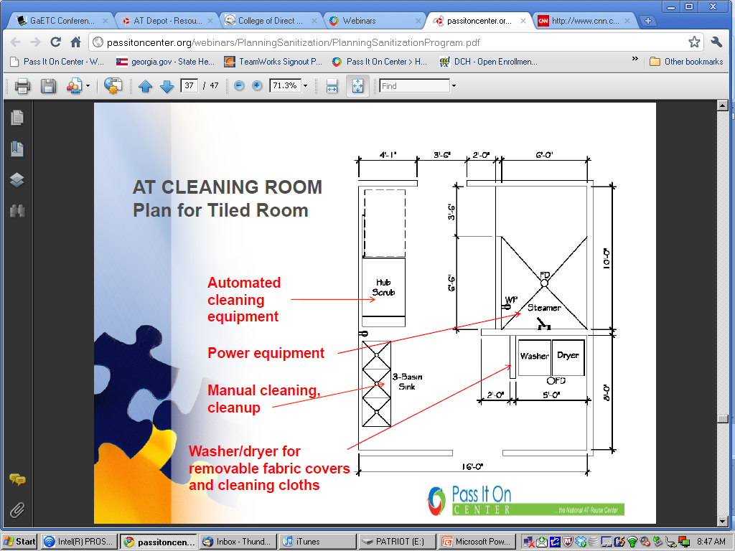

Slide 27
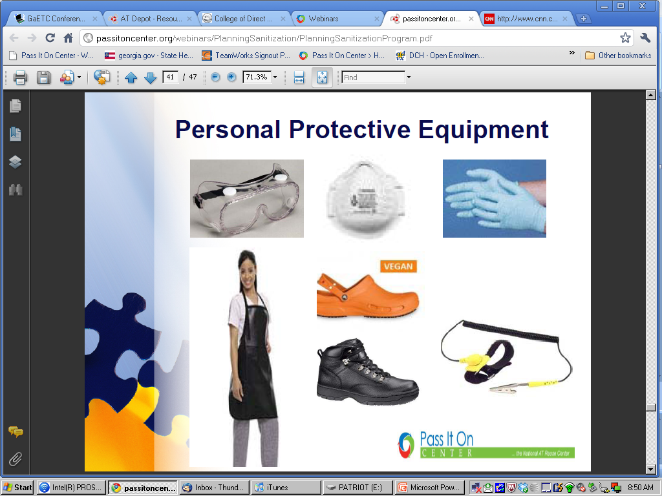

Slide 28
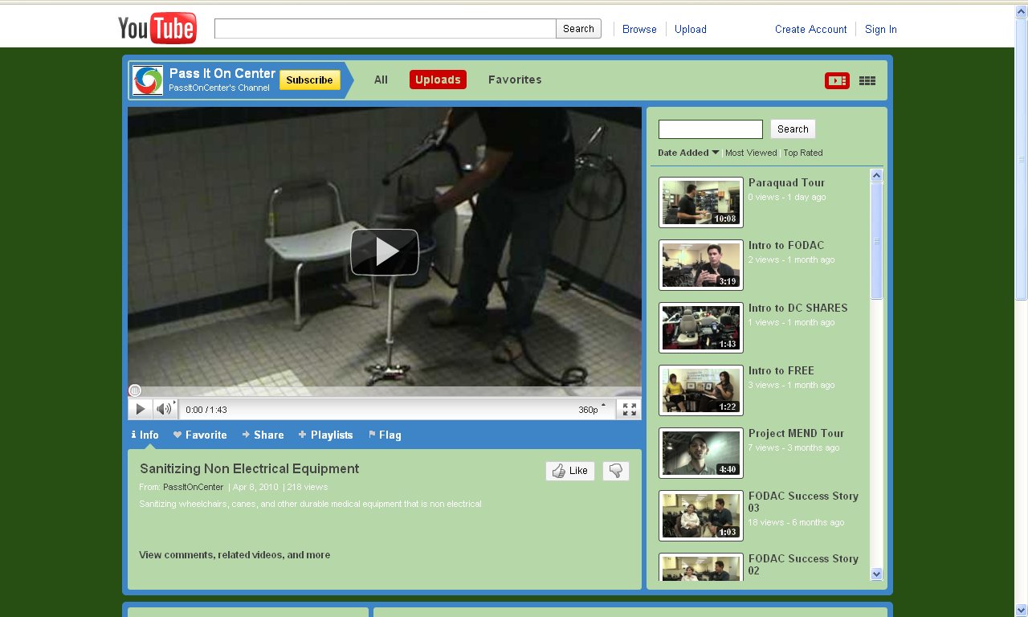

Slide 29
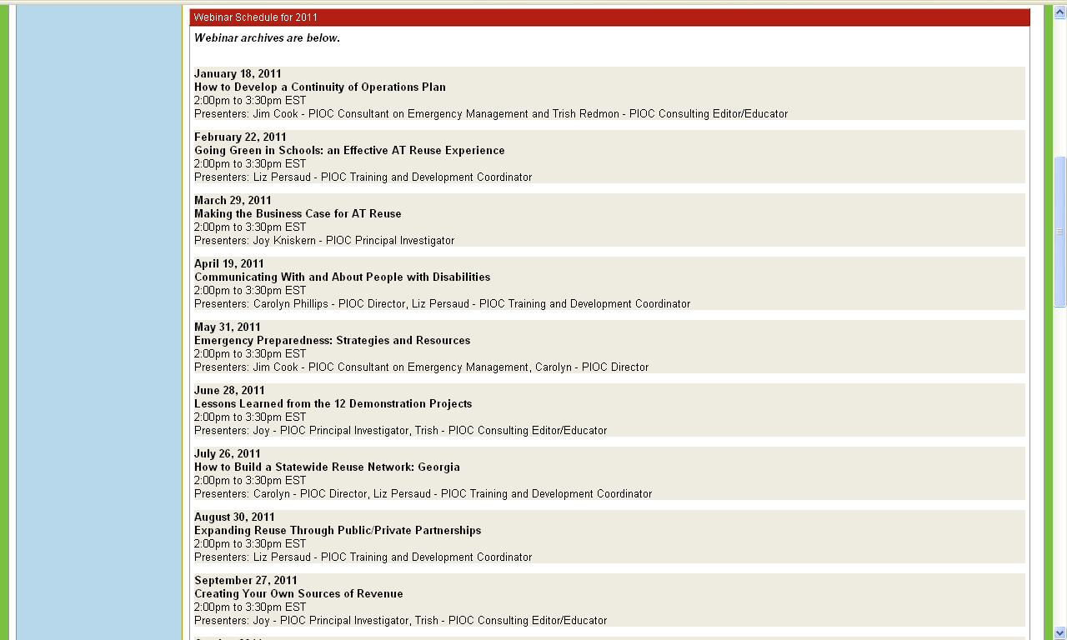
The Pass It On Center is Here to Help You!
Webinars Archives!
Notes:
CP

Slide 30
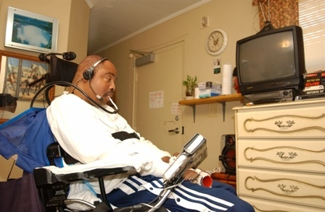
Behind every Reused Assistive Technology device there is –
A Story to be Told,
A Dream being Realized,
A Goal being Met.

Slide 31

State AT Act Programs
Fiscal Year 2014 Reutilization Data
April 2011

Slide 32

Types of Reuse Programs
Device Exchange
  Want-Ad Digest/e-Bay for AT
Device Reassignment/Refurbish
  Devices accepted (usually by donation) into an inventory; are repaired, sanitized, and/or refurbished as needed; and then offered for sale, loan, rental, or give away to consumers as recycled products.
  Includes devices repaired for an individual (without the ownership of the device changing hands)
Open-Ended Loan
  Borrower of a device can keep the device as long as needed

Slide 33
2006 – 2014 Data Comparison

Slide 34
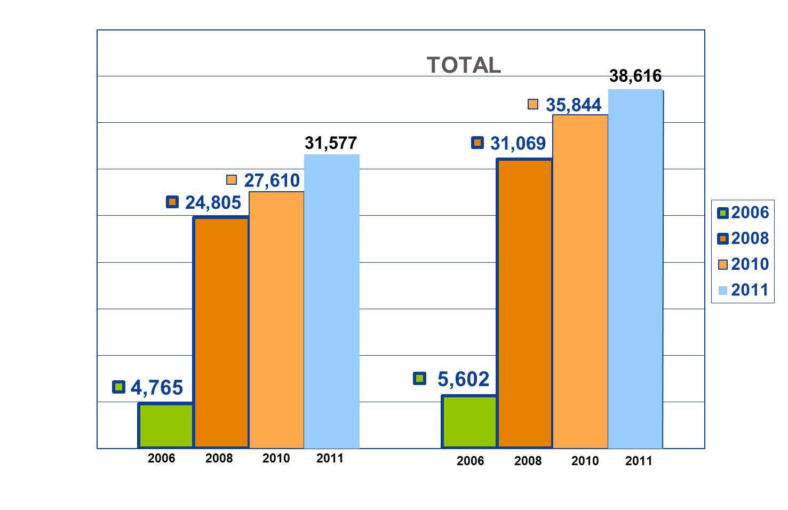
2006 – 2014 Data Comparison
TOTAL RECIPIENTS

Slide 35
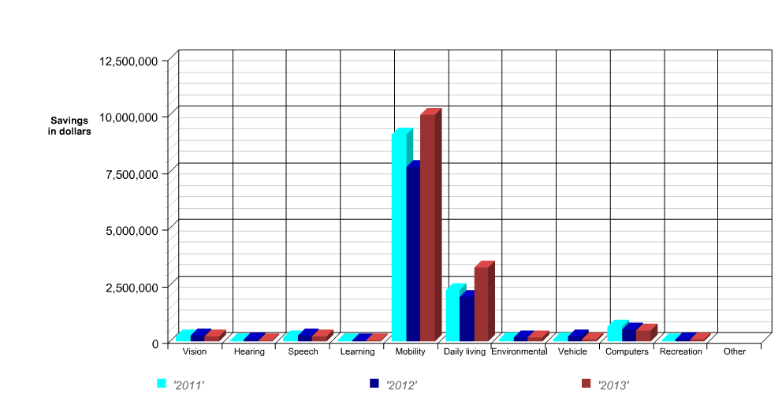

Slide 36
Expanding ROI to include more than the value of reused equipment
Calculation of Approximate Value of Investment in AT Reutilization
Value of Reusable AT Devices
Value of Avoided Healthcare Costs
Environmental Impact Savings
Economic Value of Work
CAVIAR
Sum values
Subtract program expenses
Divide result by program expenses
Improved ROI
KS: ROI VA KS, GA VA

Slide 37
Recalculating for Kansas
Original ROI
Adding avoided healthcare costs
Using only the value of the equipment:
FY 2011 data resulted in a Return on Investment (ROI) of $3.49 for each dollar invested.
For FY 2011, assuming that only one percent of Kansans who received DME delayed or avoided a move to assisted living (versus 8% in Virginia), the ROI went to $4.13 for every dollar invested, an increase of 18%.

Slide 38
Using CAVIAR to calculate ROI
Pass It On Center will prepare a paper on this extended model for ROI.
We would like to have some programs volunteer to participate in this expanded calculation. If you’re interested, please contact Joy Kniskern or Trish Redmon at Pass It On Center.
Many thanks to Sara Sack and Sonja Schaible for your leadership in making the business case for AT reuse.

Slide 39
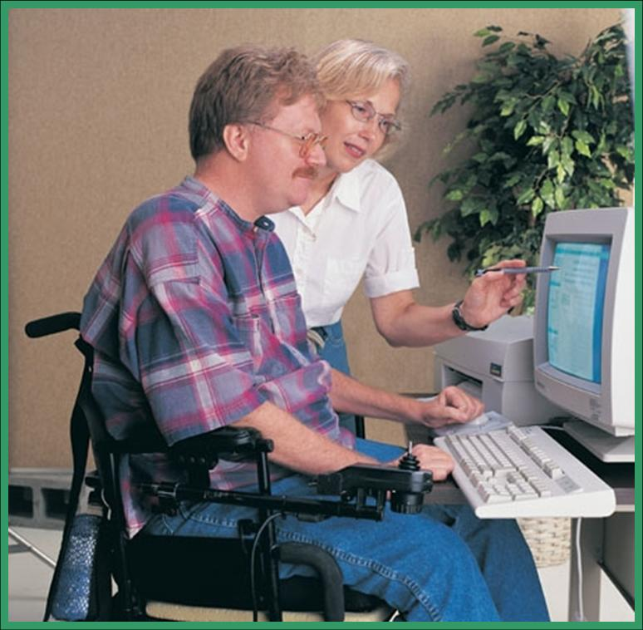

Sara Sack
  AT Reuse Partnerships with Medicaid
  Medicaid programs are showing increasing interest in the reuse of durable medical equipment (DME).
  Do you want a partnership with Medicaid?
Expanding Reuse Through Specific Events:
Checking inventory at the Kansas Equipment Exchange
Notes:
SS, JK

Slide 40
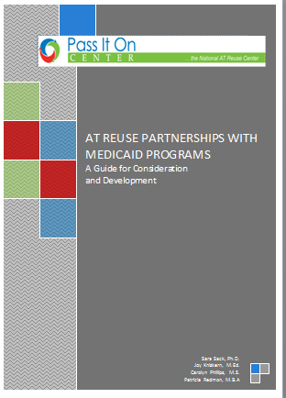
Expanding Reuse Through Specific Events:
Notes:
SS, JK

Slide 41
Examples of Reuse Programs
AT Specific Program:
  AAC
  Perkins Braille
  CCTVs
  Smartphones/tablets
  Hearing Aids
  DME
  Computers

Slide 42
Connecting the Dots In Your Community
Equipment
Management
Plan?
Sustainability
Plan?
Participant
Matching &
Training
Plan?
Your
AT Reuse
Network
Staff/Volunteers
Skilled
Techs?
Marketing
Plan?
Participants?
Donors?
Strategic
Partnership
Plan?
Policies?
Liability?

Slide 43

Questions
Questions?

Slide 44
Contact us:
carolyn@passitoncenter.org
Joy@passitoncenter.org
liz@passitoncenter.org
DISCLAIMER
This work is supported under five-year cooperative agreement #H235V060016 awarded by the U.S. Department of Education, Office of Special Education and Rehabilitative Services, and is administered by the Pass It On Center of the Georgia Department of Labor – Tools for Life. However, the contents of this publication do not necessarily represent the policy or opinions of the U.S. Department of Education, or the Georgia Department of Labor, and the reader should not assume endorsement of this document by the Federal government or the Georgia Department of Labor.
http://www.passitoncenter.org

