Slide 1
Policies and Procedures and How to use SRI Database

Slide 2
Policies and Procedures for Device Loans
Device demonstrations compare the features and benefits of a particular AT device or category of devices for an individual or small group of individuals. The purpose of a device demonstration is to enable an individual to make an informed choice.
Catalyst

Slide 3
Policy: Demonstrations are to be conducted by knowledgeable staff who will compare the features and benefits of a particular AT device/software for an individual or small group of individuals.

Slide 4
Policy: Demonstrations can be given at a scheduled appointment, assessment, tour, training, or walk-in.

Slide 5
Policy: Prior to demonstrations, a knowledgeable staff member will check the items to be demonstrated that they are working and are in the lab

Slide 6
Policy: At the end of demonstration, all demos should be recorded in the Tools for Life staff database section under the Device Demo tab and clean up in AT Demo lab

Slide 7
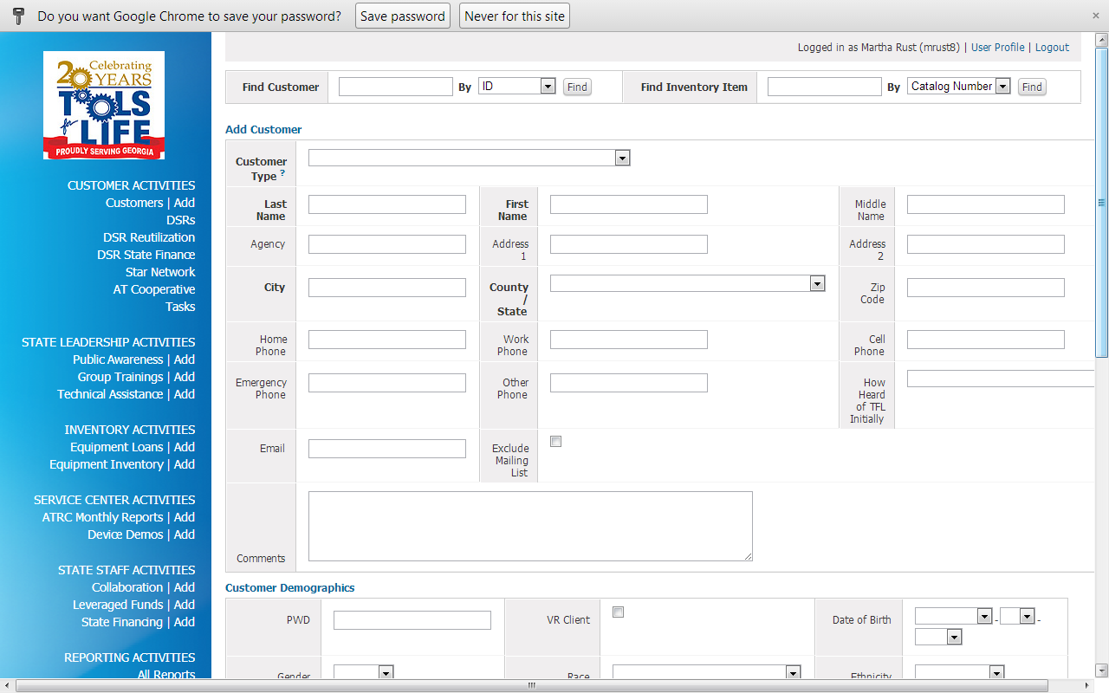
Adding New Customer
Click Add by
Customer

Slide 8
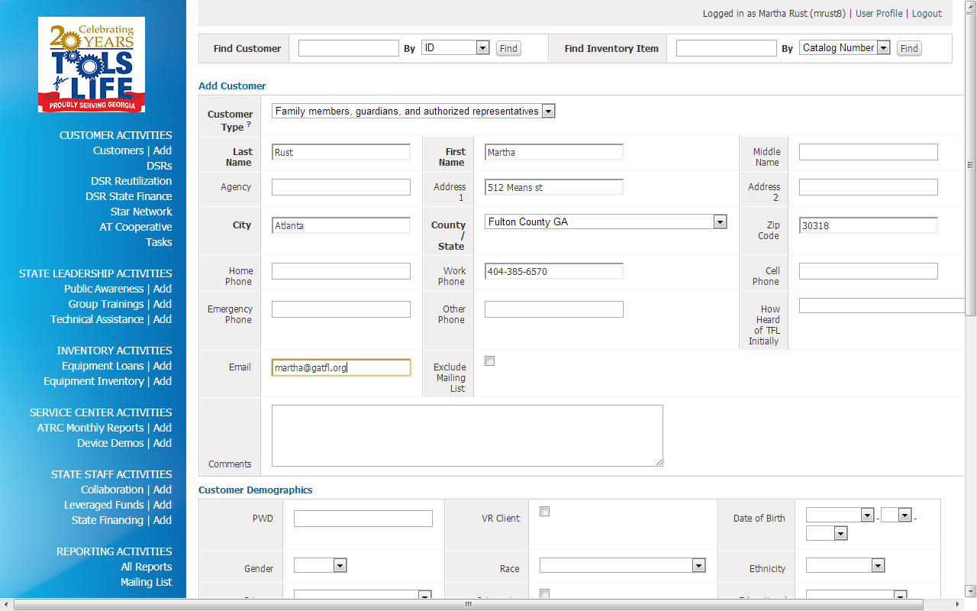
Complete entire form
Click Add at the
bottom

Slide 9
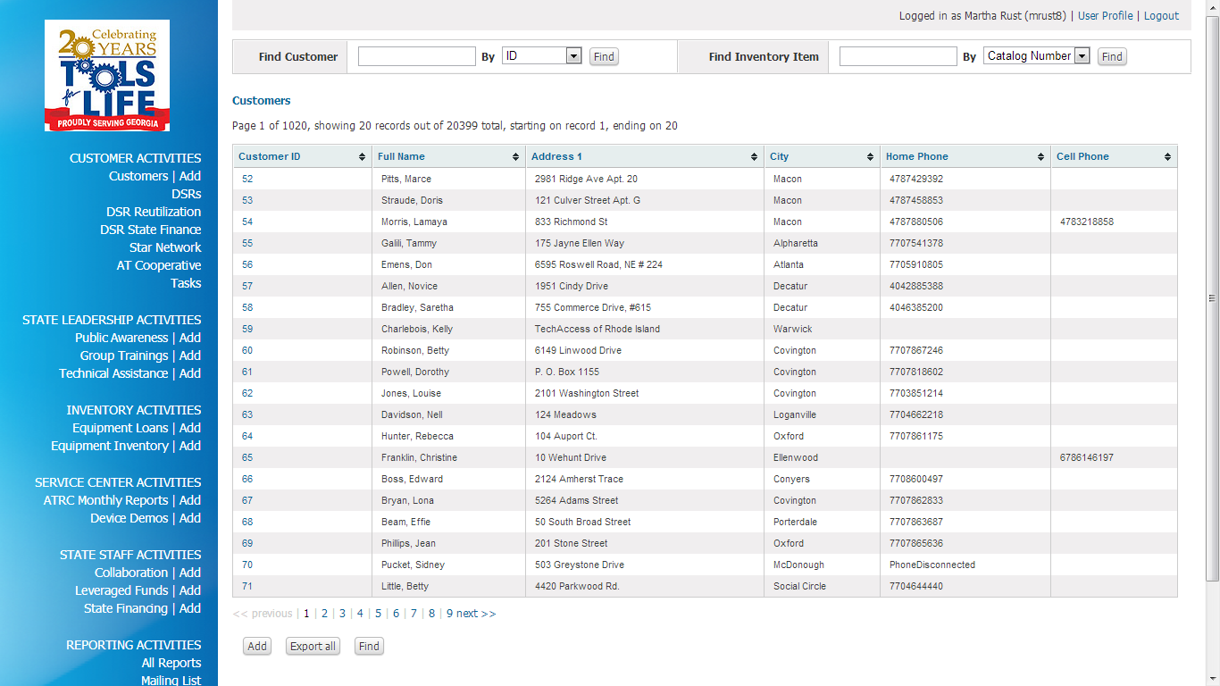
Adding a new DSR
Click on Customer
Choose the Individual you would like to add
You can use search box that the top to Search by ID or Last Name

Slide 10
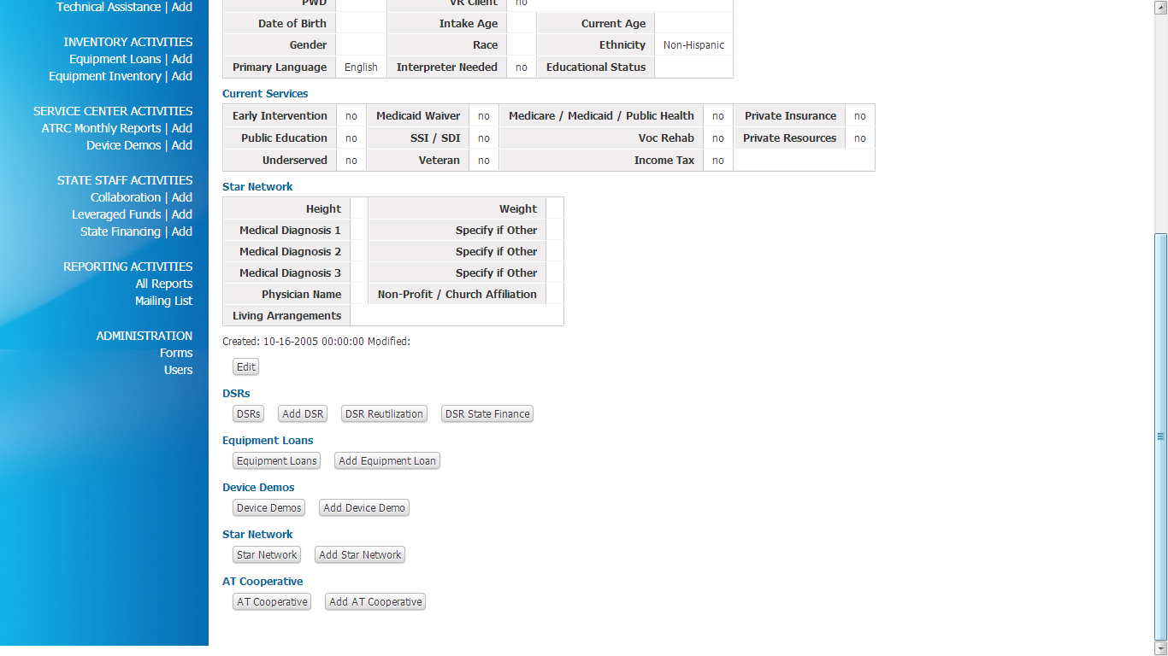
Once you have selected the individual you will scroll to the bottom and will see DSRS
Click on Add DSR

Slide 11
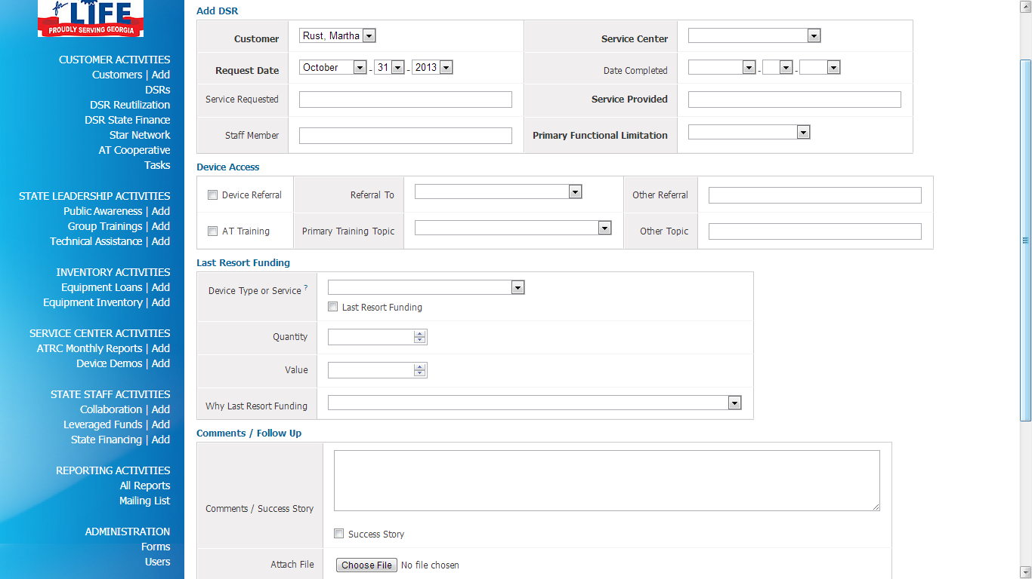
You will complete the DSR form
Be sure to add your Service Center
You have to opportunity to attach a file for the Success Story
When completed you will Click Add underneath the Success Story

Slide 12
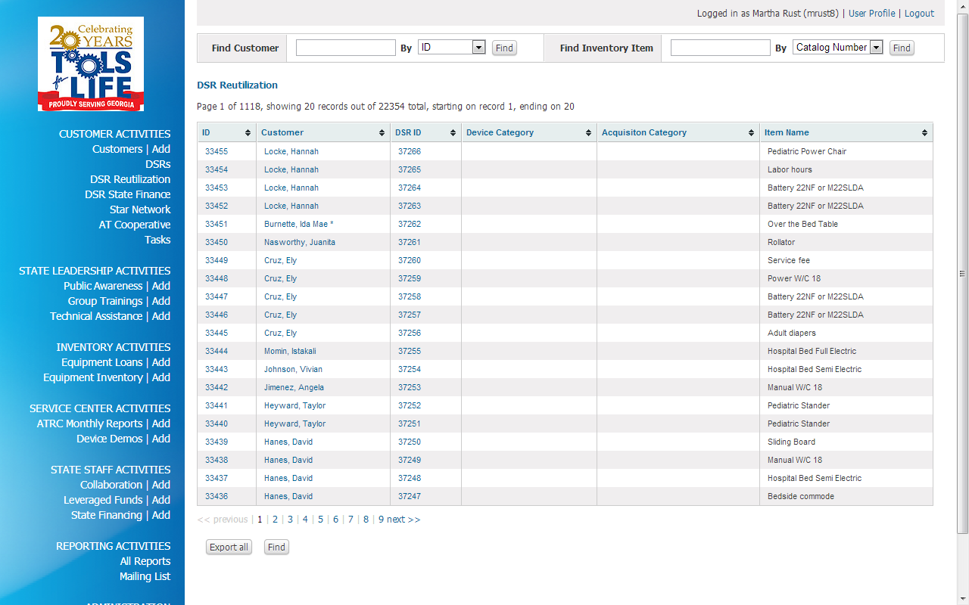
Adding New DSR Reutilization
Click on DSR
Reutilization
Find Customer by ID
or Last Name

Slide 13
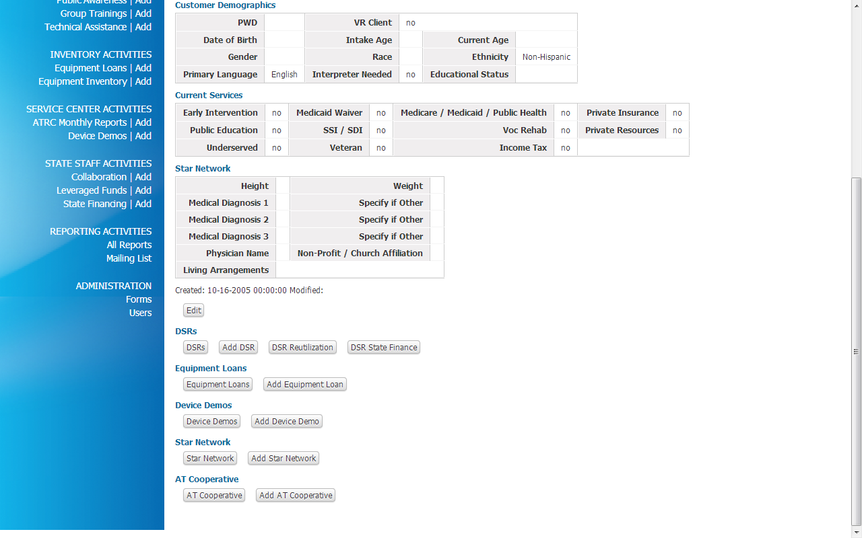
Scroll to bottom
and click on Add
Star Network

Slide 14
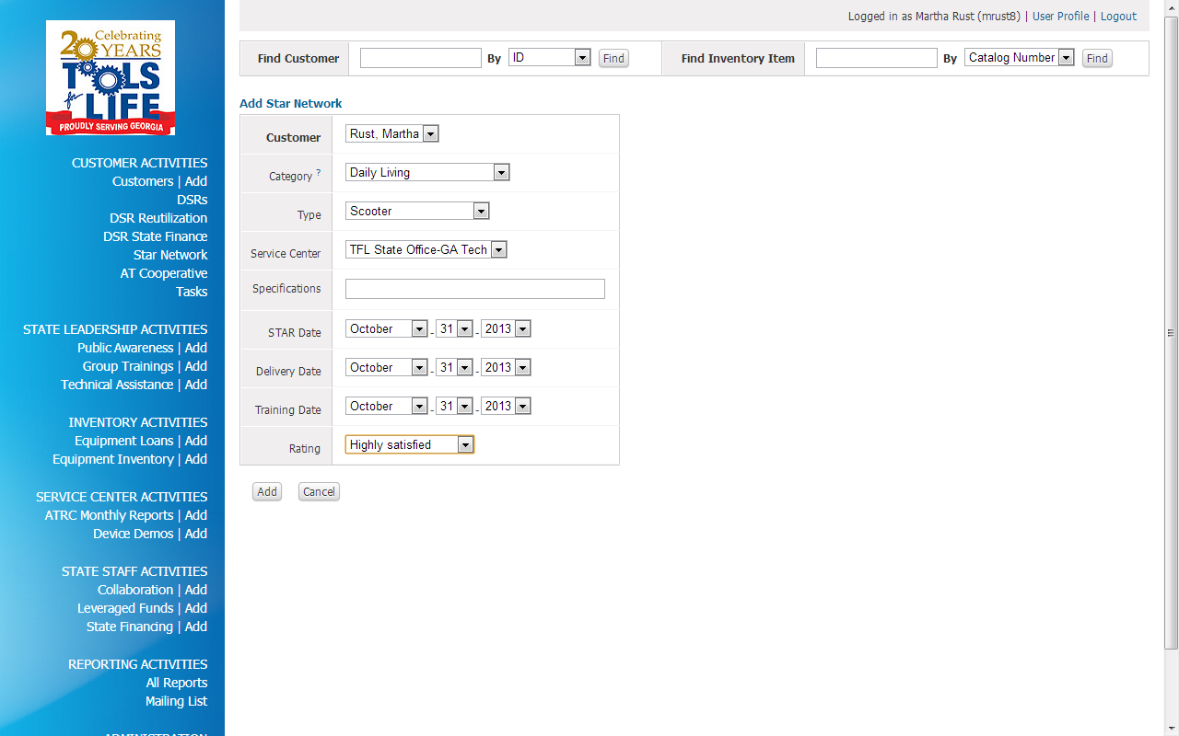
Fill out Form
Click Add

Slide 15
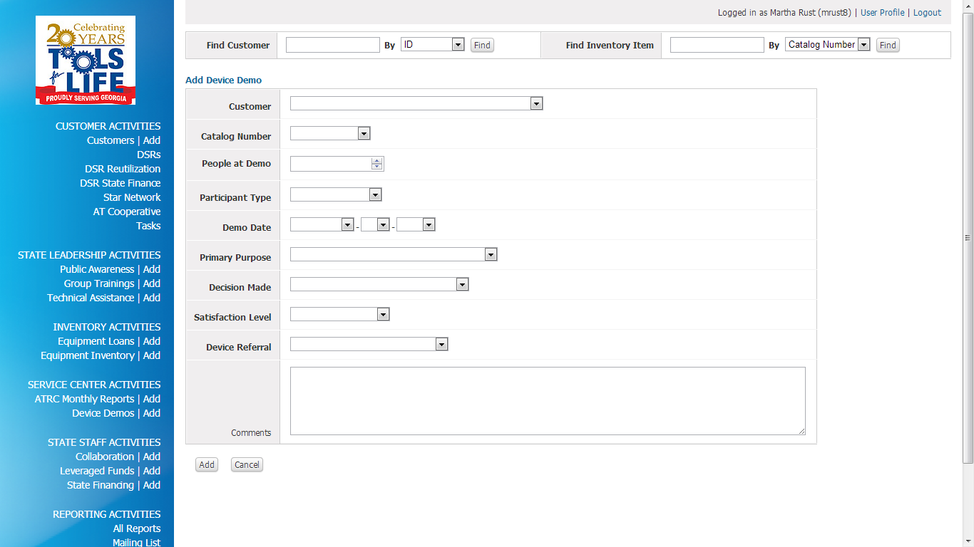
Adding Device Demo
Click on Add beside Device Demo

Slide 16
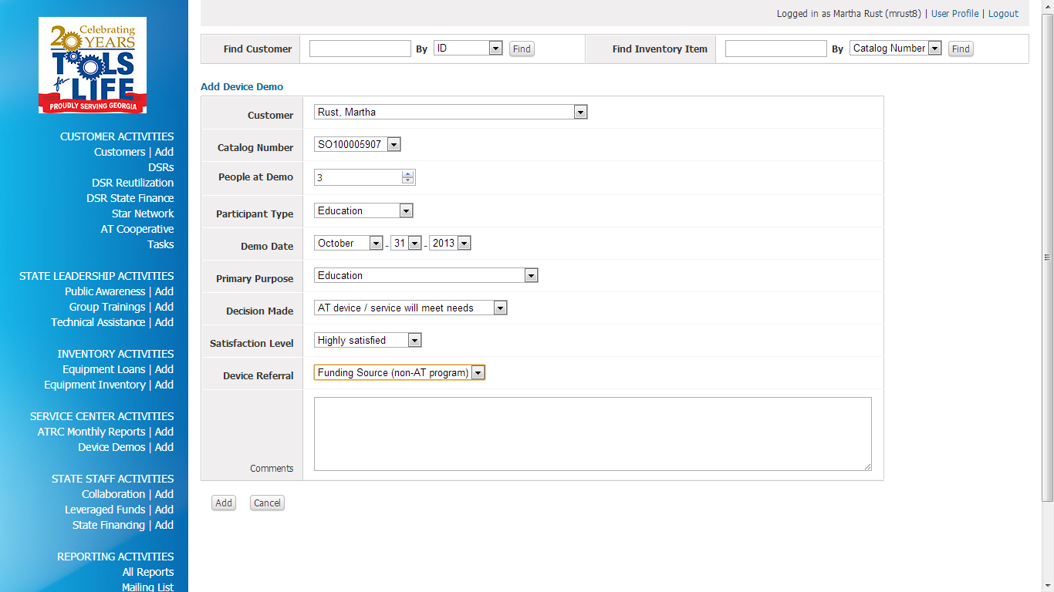
Click to choose your individual
Complete Form
Number of people at the demo includes family members, teachers, therapists, etc
Click Add

Slide 17
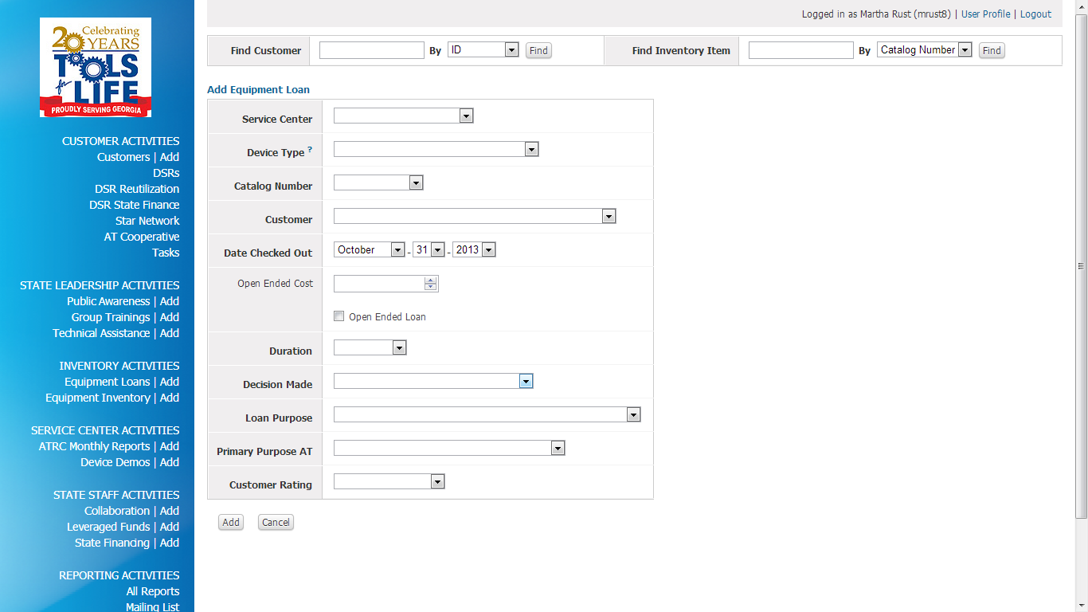
Equipment Loan
Click on Add beside Equipment Loan

Slide 18
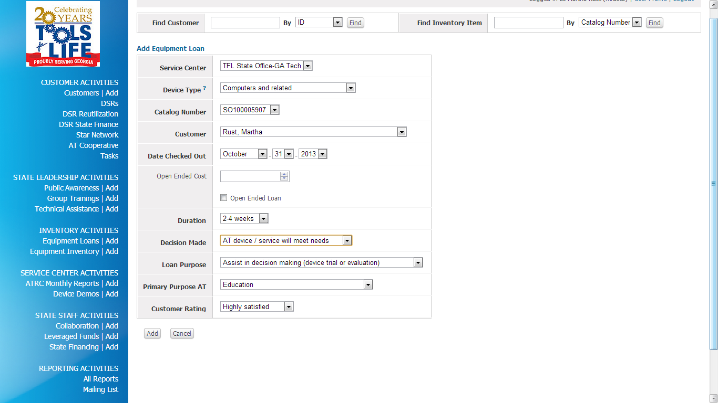
Complete the form
Click Add

Slide 19
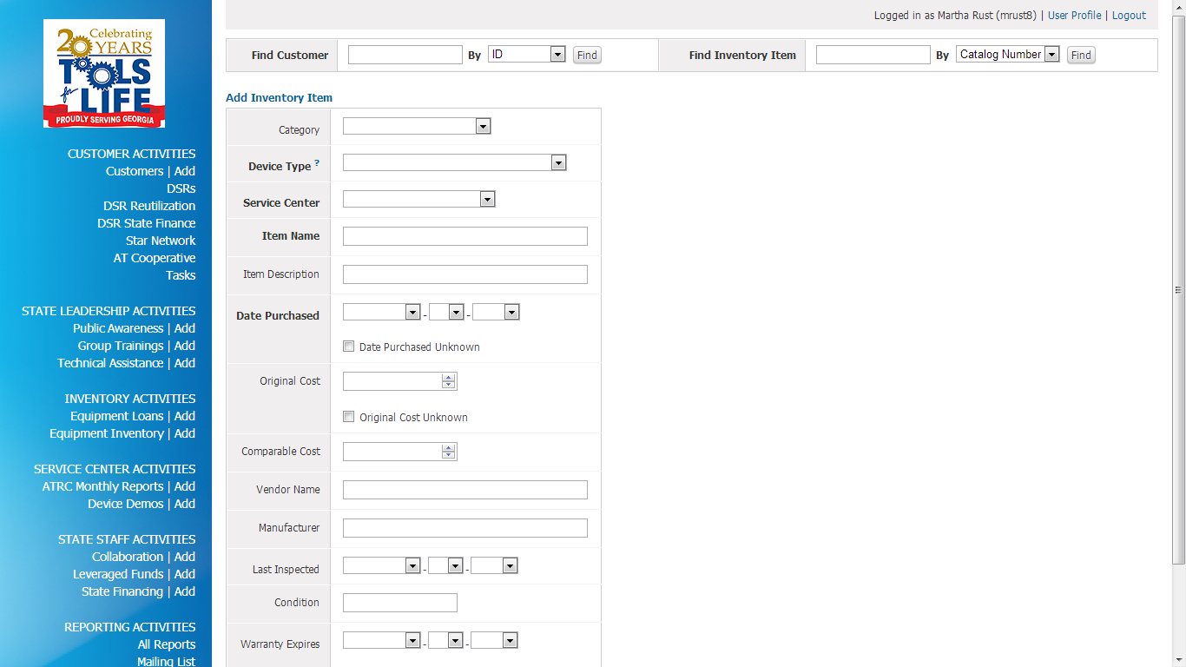
Adding New Inventory
Click on Add beside Equipment Inventory

Slide 20
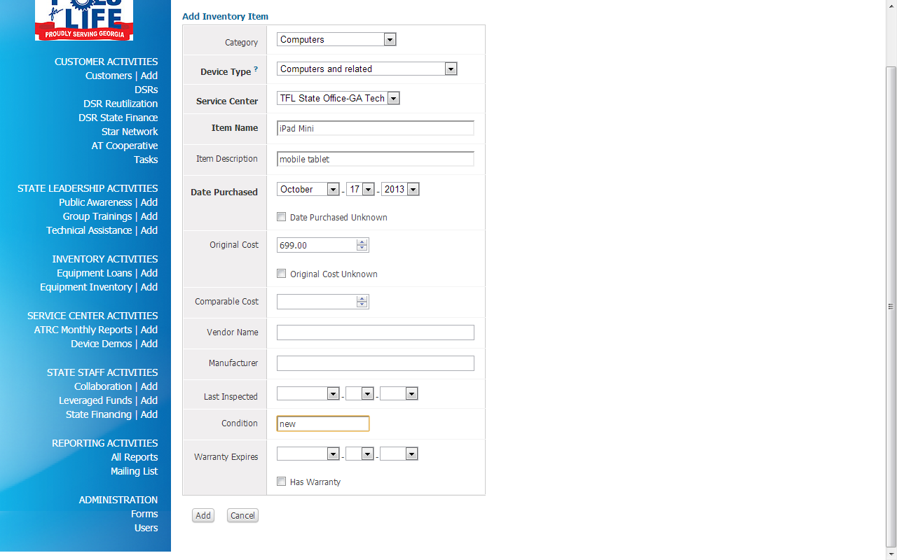
Fill out the form
Click Add at the
bottom

Slide 21
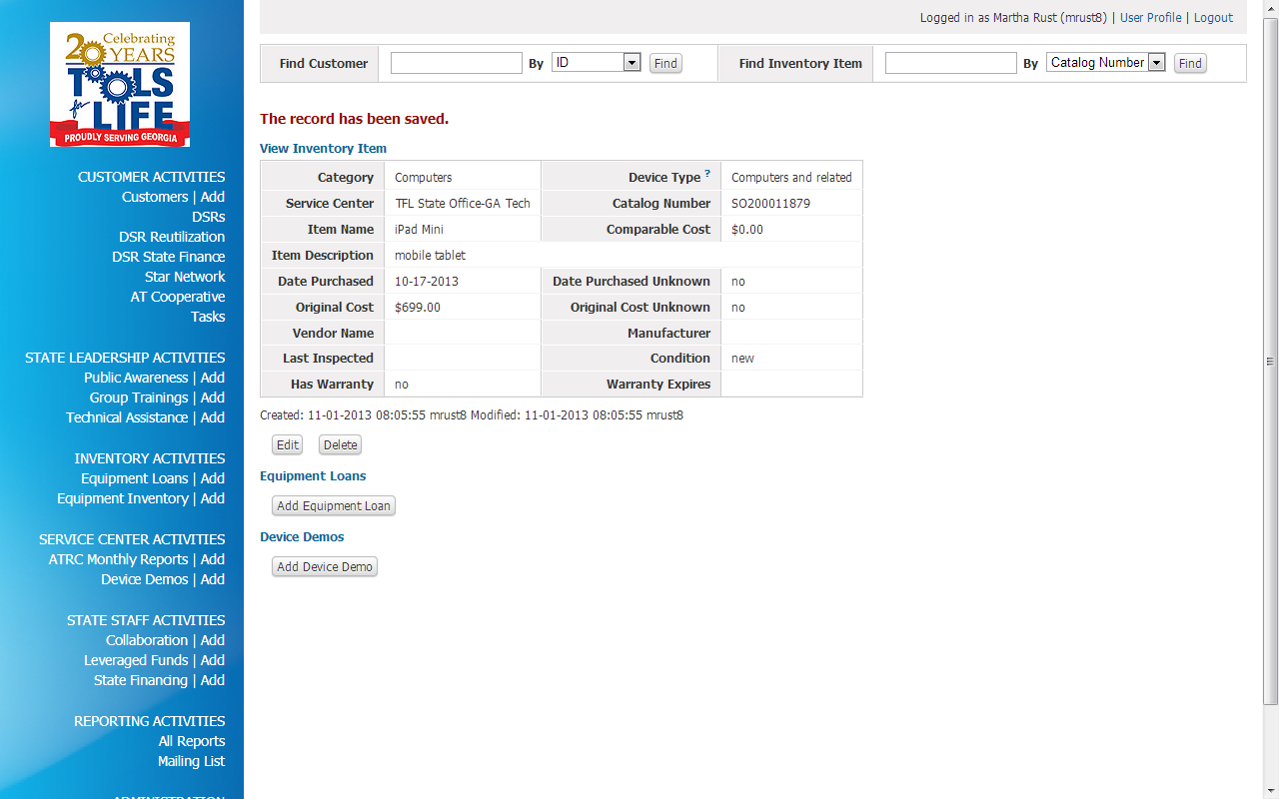
Generates bar code number
Gives you the opportunity to edit
or delete
Equipment Loan
Device Loan

