Slide 1
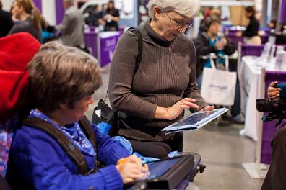
Tools for Life Mission
We’re here to help Georgians with disabilities gain access to and acquisition of assistive technology devices and assistive technology services so they can live, learn, work, and play independently in the communities of their choice.

Slide 2
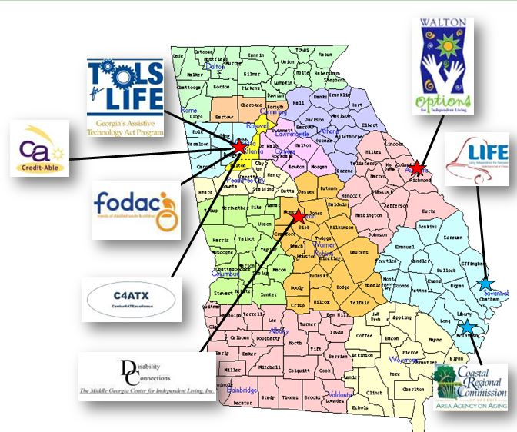
TFL Network

Slide 3
TFL AppFinder

Slide 4
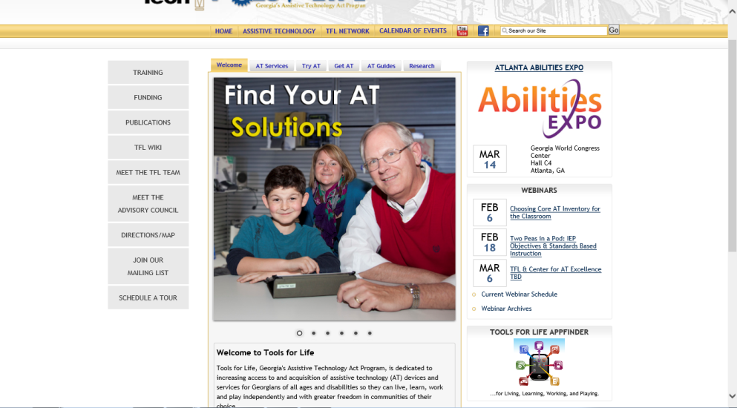
Come Visit Us!

Slide 6
Join us in the Canterbury Room for the Assistive Technology Solutions Lab on Thursday – 9:00 to 5:15!
SIG/ADRC Conference, August 13-15, 2014
100 Assistive Technology Solutions!
Check it out!

Slide 7
Welcome to the Assistive Technology Revolution!
The world around us is evolving at an astounding rate. Assistive Technology developments have been foundational in this evolution and a catalyst for producing positive life-changing results for individuals with disabilities.
We will also discuss possible solutions to expedite knowledge transfer from research journals to your clients whether they are in school, at home, at work or in the community. For Handouts: http://www.gatfl.gatech.edu/tflwiki

Slide 8
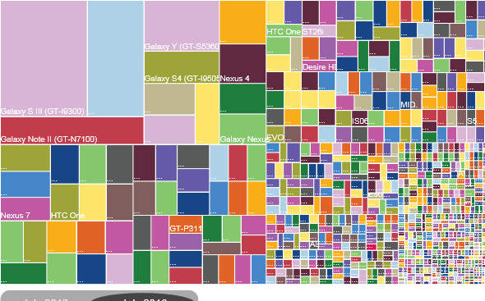
Android Device Fragmentation
July 2012: 3,997
Different Android Devices
July 2013: 11,868
Different Android Devices
July 30, 2013 http://www.ign.com/articles/2013/07/30/heres-what-android-fragmentation-looks-like
Ben Satterfield

Slide 9
Convergence
Single tech platform to perform multiple tasks
Run multiple applications
Application for access & accommodations
Application for productivity
Accessible e-book reading devices
Online sites for digital libraries/repositories
Kirk Behnke, M.Ed., ATP

Slide 10
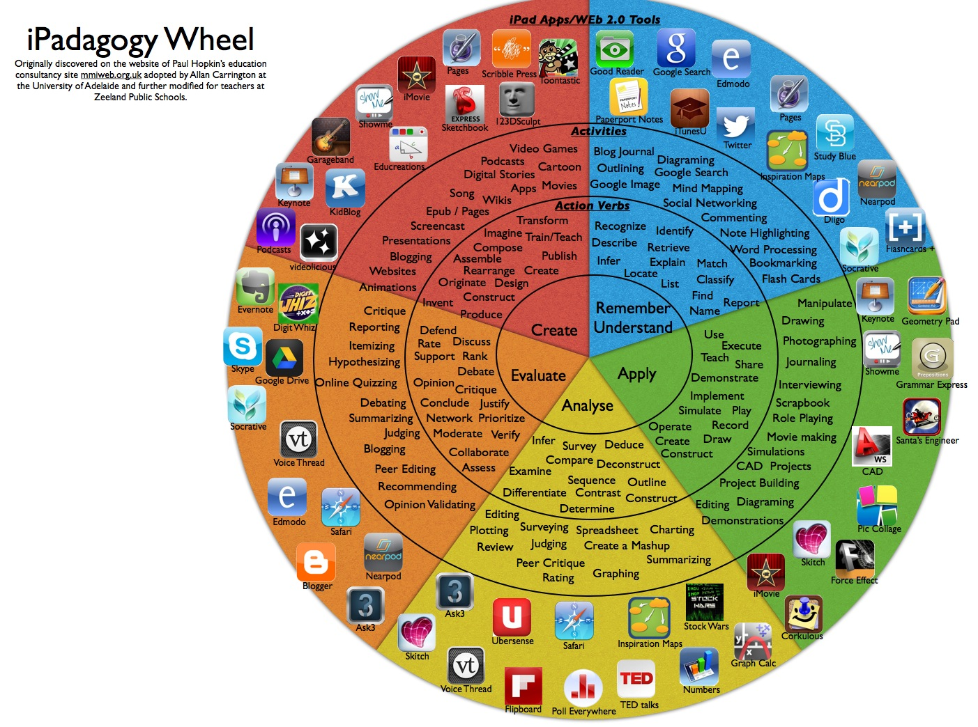

Slide 11
Vgo Website

Slide 12
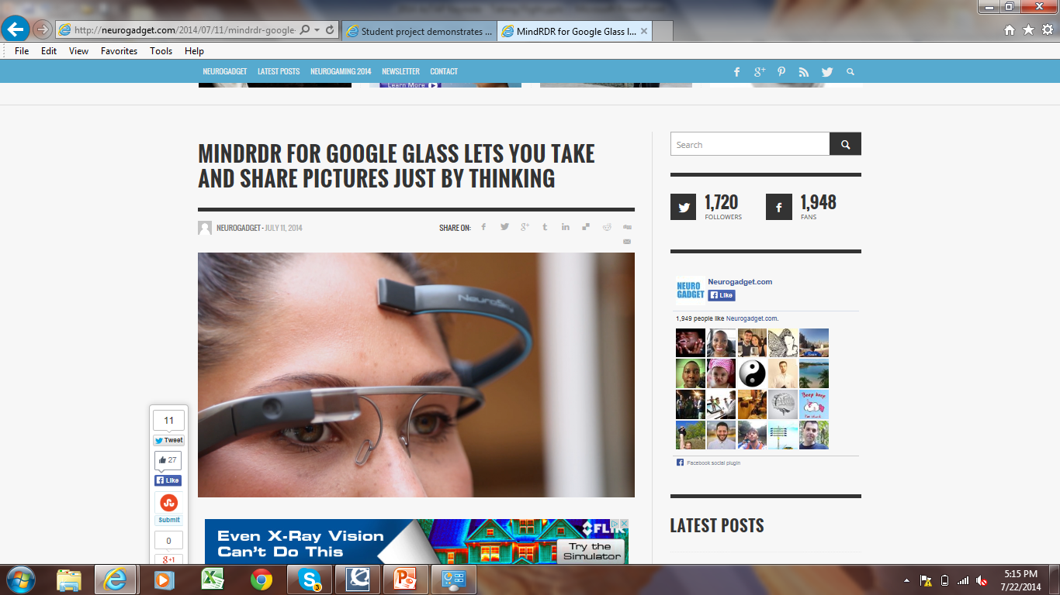

Slide 13
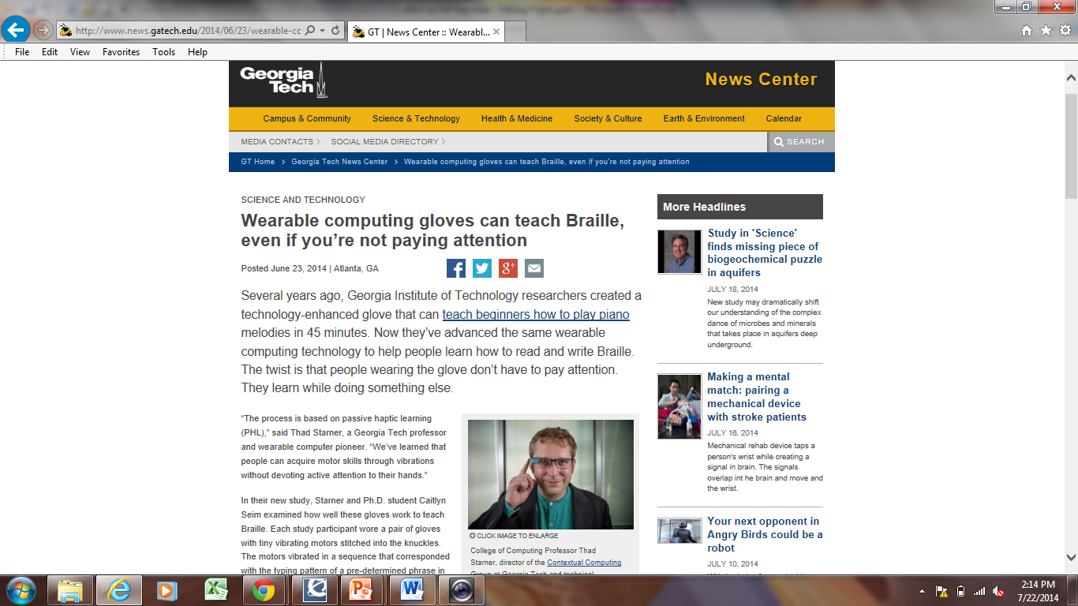

Slide 14
TechSage Mission
To conduct programs of advanced rehabilitation engineering (RE) and technical R&D to increase knowledge about, availability of, and access to effective, universally-designed technologies that enable people to sustain independence, maintain health, safely engage in basic activities of daily living at home and community, and participate in society as they age with disability.

Slide 15
Join us in the Canterbury Room
SIG/ADRC Conference, August 13-15, 2014
Introduction to Assistive Technology Across the Lifespan: 9-10:15
Top 10 Count Down of Assistive Technology: 1-2:15
Back to Basics Tablets and Apps: 2:30-3:45
Tea and Talk about Assistive Technology: 4-5:15
100 Assisitve Technology Solutions!
Check it out!

Slide 16
Seize this Opportunity!
Challenge:
Learn 3
Teach 3

Slide 17
We are Here to Help You!
Tools for Life Advisory Council - http://www.gatfl.gatech.edu/tflwiki/index.php?title=Advisory_Council
Tools for Life AT Network - http://www.gatfl.gatech.edu/network.php
Carolyn Phillips
Director of Tools for Life
Carolyn.Phillips@gatfl.gatech.edu
Ben Jacobs
Accommodations Specialist
Ben.Jacobs@gatfl.gatech.edu
Liz Persaud
Training, Outreach and Development Coordinator
Liz.Persaud@gatfl.gatech.edu
Martha Rust
AT Specialist
Martha.Rust@gatfl.gatech.edu
Rachel Wilson
TechMatch Specialist
Rachel.Wilson@gatfl.gatech.edu
Disclaimer
This presentation is produced by Tools for Life which is a result of the Assistive Technology Act of 1998, as amended in 2004. It is a program of the Georgia Institute of Technology, College of Architecture, AMAC Accessibility Solutions and is funded by grant #H224C030009 of the Rehabilitation Services Administration (RSA), Department of Education. The contents of this presentation were developed under a grant from the Department of Education. However, those contents do not necessarily represent the policy of the Department of Education, Georgia Tech, COA or AMAC and you should not assume endorsement by the Federal government.

