Slide 1
Exploring College and Career Readiness through Assistive Technology Thursday, May 7, 2015 3:00 PM EST Carolyn Phillips and Liz Persaud, Tools for Life www.gatfl.gatech.edu For Handouts: http://www.gatfl.gatech.edu/tflwiki

Slide 2
This Session is being Recorded
You will be able to access the archive of this and other webinars at www.gatfl.gatech.edu

Slide 3
Credits
CEUs are approved for .10 clock hours and are administered through Georgia Tech Professional Education
CRCs are approved for 1.0 clock hours by the Commission on Rehabilitation Counselor Certification
To receive your verification form, send an e-mail with the webinar title and date to Liz.Persaud@gatfl.gatech.edu

Slide 4
Webinar Evaluation
At the end of today’s webinar, we ask that you please take a moment to complete our survey:
https://www.research.net/s/TFLwebinar

Slide 5
Join us for Upcoming Events!
IDEAS Conference
June 2-6, 2015
Epworth by the Sea, St. Simon’s Island
Visit www.gatfl.org for the full schedule and to sign up on the TFL mailing list to receive our email announcements.
Notes:
Liz

Slide 6
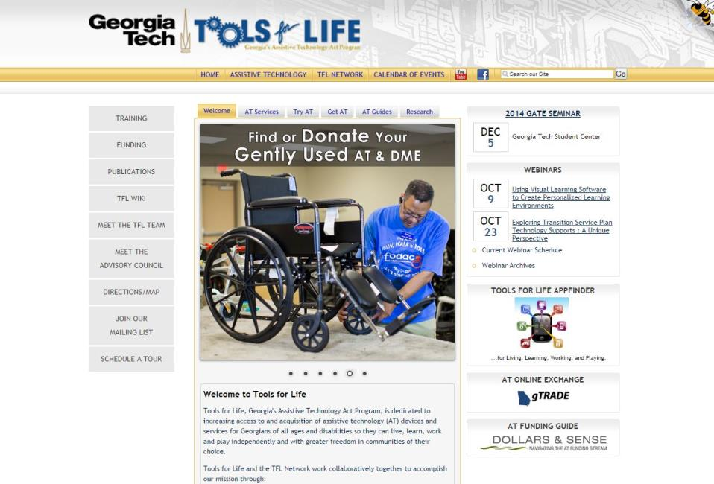
Webinar Updates & Schedule
Liz Persaud

Slide 7
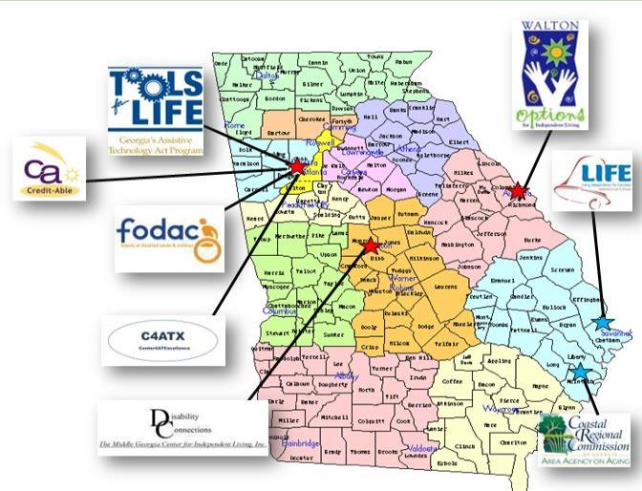
Tools for Life Network
AT Lending Library
AT Evaluations & Training
AT Demos
Resource and Assistance
AT Funding Assistance
DME Reuse

Slide 8
Exploring College and Career Readiness through Assistive Technology…

Slide 9
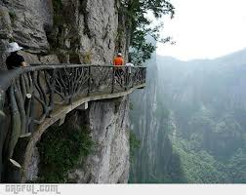
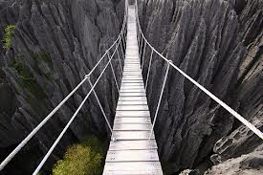
AKA:
Welcome to Creative Trail
& Bridge Building 101!

Slide 10
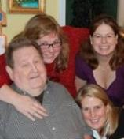
Guiding Principles
We – Collectively – are Brilliant & Can find an Innovative Path and Create Brighter Futures
Smooth Transitions Make The Difference!
We must Think, Live and Act from a place of Abundance – We have enough time, money, resources.
We Must Focus on Abilities!
Assistive Technology is Key to Success.
Success Breeds Success
YOU have the Power to make the Difference!
Change vs. Progress (Bob Phillips)

Slide 11
Session Description
Beginning a path that leads to college or preparing for the workforce can be an overwhelming experience. This session will explore the collective role each of us play in promoting student success further through transition and the powerful role of assistive technology in this process. We will examine outcomes that can occur when universal learning design and appropriate assistive technology solutions are integrated into the lives of individuals with disabilities.
During this session participants will learn about some of the strategies and solutions being used to assist students with disabilities prepare for life beyond high school and assist with smooth transitions into the workplace and community. Presenters will discuss technological trends and share examples of assistive technology, software, hardware, mobile technology and apps.
Other resources shared will include information about AMAC Accessibility Solutions and Research Center at Georgia Tech and how their services for those with print related disabilities can help stay on the path to success.

Slide 12
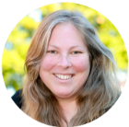
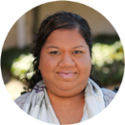
Session Presenters
Carolyn Phillips
Tools for Life Director
Liz Persaud
Training and Outreach Coordinator
Carolyn P. Phillips is nationally recognized in the field of assistive technology and disabilities. Carolyn serves as Director and Principal Investigator of Tools for Life, Georgia’s Assistive Technology (AT) Act Program at Georgia Tech | AMAC.
Liz Persaud is a nationally recognized keynote and public speaker focused on technology and disabilities. She currently serves as the Training and Outreach Coordinator of Tools for Life, Georgia’s Assistive Technology (AT) Act Program at Georgia Tech | AMAC Accessibility Solutions.

Slide 13
AMAC - Introduction
What is AMAC?
AMAC works with colleges and universities to provide students with textbooks in formats that best meet their needs, including:
E-Text, Audiobooks, and Braille.
How does AMAC work?
Students meet with their disability services office to place an order for their textbooks in the preferred format.

Slide 14
Accessibility Made Smart
AMAC creates practical solutions that work, with a focus on utility, ease of use, and high quality.
Accessibility Consulting focuses on organizational accessibility needs with evaluation, technical assistance, customer support, and website accessibility solutions.
Braille Services produces customized projects from both print materials and electronic text including partial books and chapters, or graphics only, using cutting-edge technology.
Captioning Services makes classrooms, meetings, labs, and other audio environments fully accessible for the deaf or hard-of-hearing.
For more information, please visit our website at www.amacusg.org

Slide 15
AMAC Services
AMAC creates practical solutions that work, with a focus on utility, ease of use, and high quality.
Audio Description Services makes visual information present in multimedia accessible to persons who are blind or low vision.
Professional E-Text Producers provide high-quality e-text in many formats such as PDF, DOC, DAISY, and HTML.
AMAC’s Certified Assistive Technology team provides on-site and remote assessments, demonstrations, training, and technical assistance for education, work, and daily living environments.
For more information, please visit our website at www.amacusg.org

Slide 16
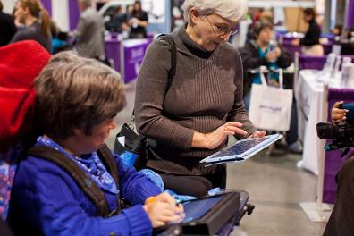
Tools for Life Mission
We’re here to help Georgians with disabilities gain access to and acquisition of assistive technology devices and assistive technology services so they can live, learn, work, and play independently in the communities of their choice.

Slide 17
The TFL Network

Slide 18
Visit us online!

Slide 19
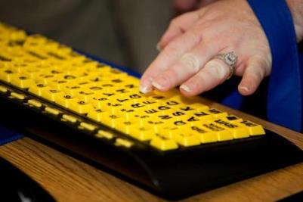
What is Assistive Technology?
Assistive Technology (AT) is any item or piece of equipment that is used to increase, maintain or improve the functional capabilities of individuals with disabilities in all aspects of life, including at school, at work, at home and in the community.
Assistive Technology ranges from no/low/light tech to high tech devices or equipment.

Slide 20
Defining Universal Design
Universal Design makes things safer, easier and more convenient for everyone.
Universal Design involves designing products and spaces so that they can be used by the widest range of people possible.

Slide 21
In the Shadows - Mainstream
Tim Cook, Apple Chief Executive
2013 speech at Auburn University
…people with disabilities are "in a struggle to have their human dignity acknowledged."
"They're frequently left in the shadows of technological advancements that are a source of empowerment and attainment for others."

Slide 22
Mainstream Example: Mobile/Smart Phones
iPhone - mobile phone in the mainstream market.
Apple included a screen reader in the IOS for every iPhone.
Increased Access for everyone – especially individuals with disabilities
Decreased Cost – not as costly as it would be for a company specializing on screen readers
Moved us Out of the Shadows, Into the Light!

Slide 23
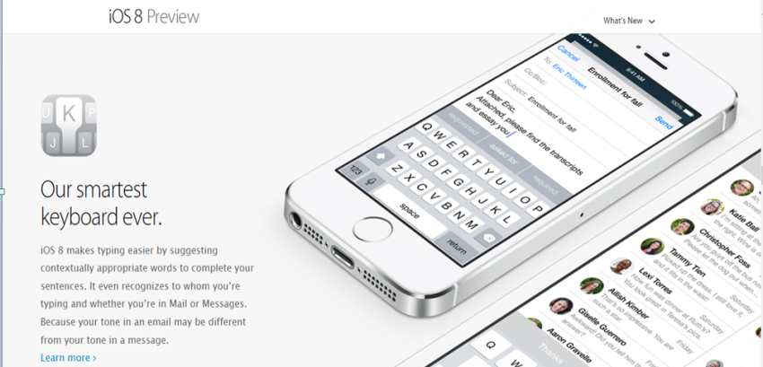
iOS 8 – released in 2014

Slide 24
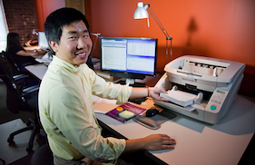
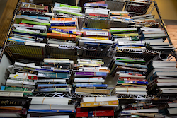
AMAC History
AMAC was created in 2005, as an initiative of the Board of Regents University System of Georgia, to help post-secondary disability services offices provide complete, timely, and efficient accommodations to the students with print disabilities that they serve.

Slide 25
Products and Services
Braille Services produces customized projects from both print materials and electronic text including partial books and chapters or graphics only using cutting-edge technology.
Professional E-Text Producers provide high-quality e-text in many formats such as PDF, DOC, DAISY, and HTML.
Captioning Services makes classrooms, meetings, labs and other audio environments fully accessible for deaf or hard-of-hearing.
Certified Assistive Technology Team provides on-site and remote assessments, demonstrations, training and technical assistance for education, work, and daily living environments.
Accessibility Compliance focuses on organizational accessibility needs with evaluation, technical assistance, customer support, and website accessibility.

Slide 26
What is Audio Description?
Audio description, also known as video description or visual description, is an additional narration track intended primarily for consumers of visual media (including television and film, dance, opera, and visual art).
It consists of a narrator talking through the presentation, describing what is happening on the screen or stage during the natural pauses.

Slide 27
What is Closed Captioning?
Closed captioning (CC) is a process of displaying text on a television, video screen, or other visual display to provide additional or interpretive information.
Closed captioning is typically used as a transcription of the audio portion of a program as it occurs (either verbatim or in edited form), sometimes including descriptions of non-speech elements.

Slide 28
What is Open Captioning?
"Open", "burned-in", "baked on", or "hard-coded" captions are visible to all viewers.
The term "closed" versus "open" indicates that the captions are not visible until activated by the viewer, usually via the remote control or menu option.

Slide 29
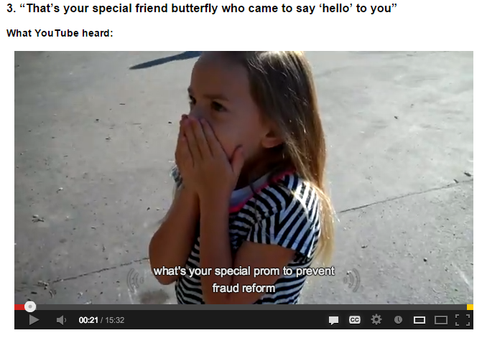
Closed Captioning: Quality Matters
Automated Captions: Human Eyes Need to Review

Slide 30
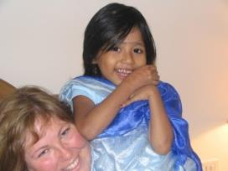
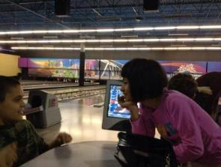
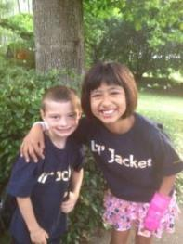
Carolyn - Why Am I Here Today?
Master Our Skills!
Expand Our Knowledge and
Build Stronger Schools to Create an amazing, Inclusive and United Community!

Slide 31
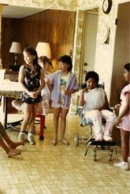
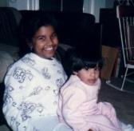
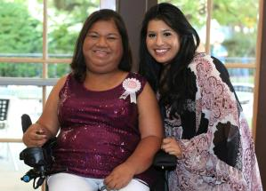
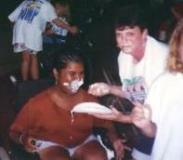
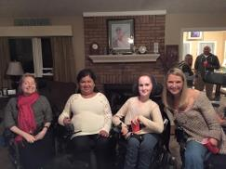
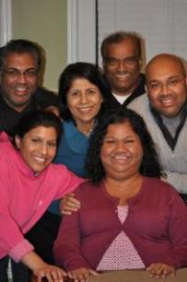
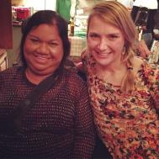
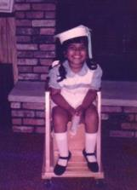
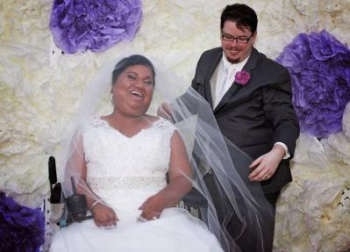
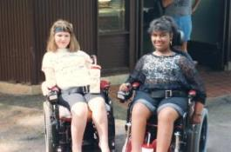
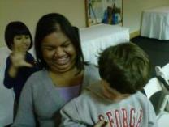
Liz - Why Am I Here Today?
Notes:
Liz

Slide 32
Begin with the End in Mind!

Slide 33
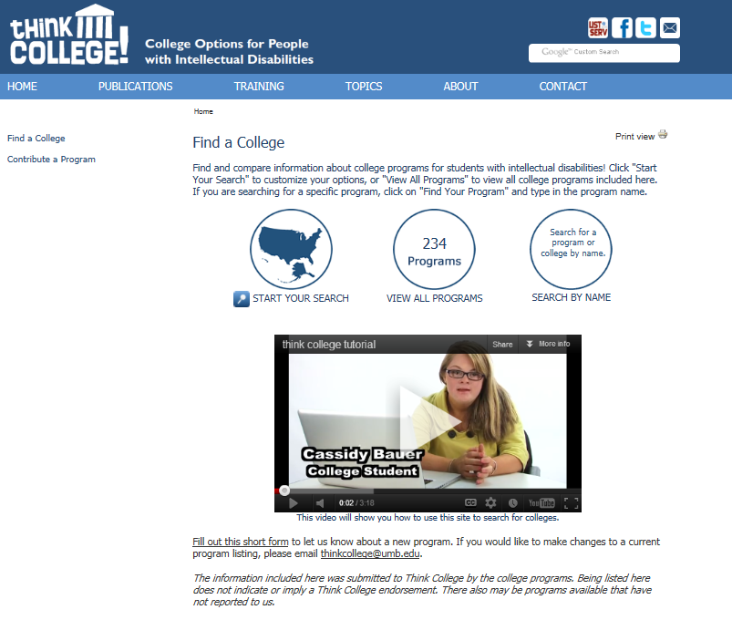
Think College Opportunities

Slide 34
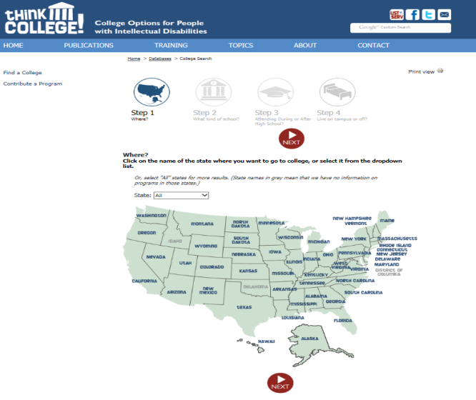
Finding Inclusive College Opportunities

Slide 35
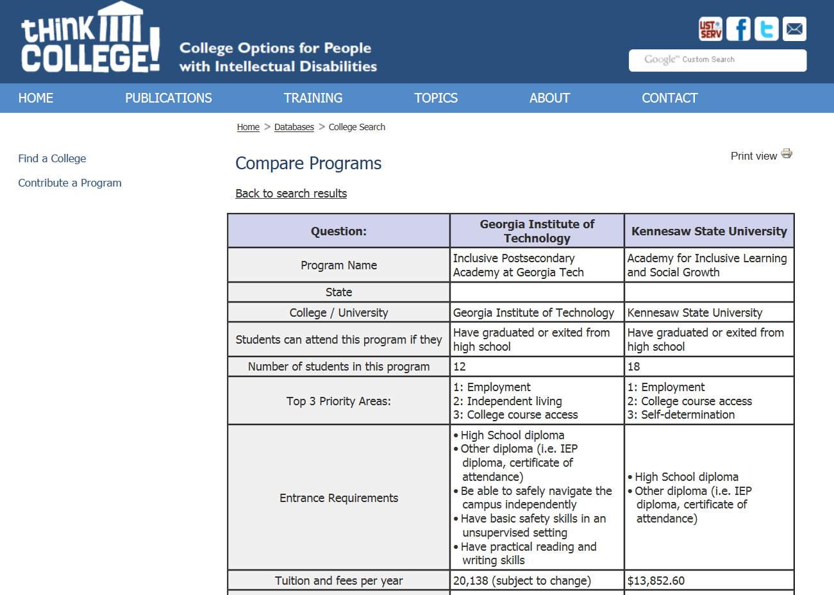
Inclusive College Opportunities in GA

Slide 36
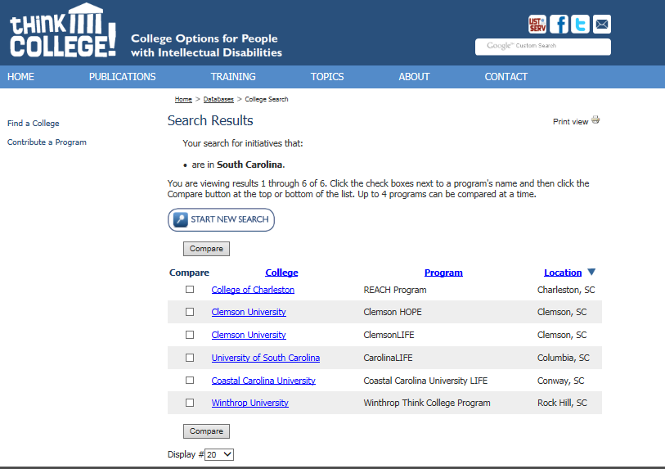
Inclusive College Opportunities in SC

Slide 37
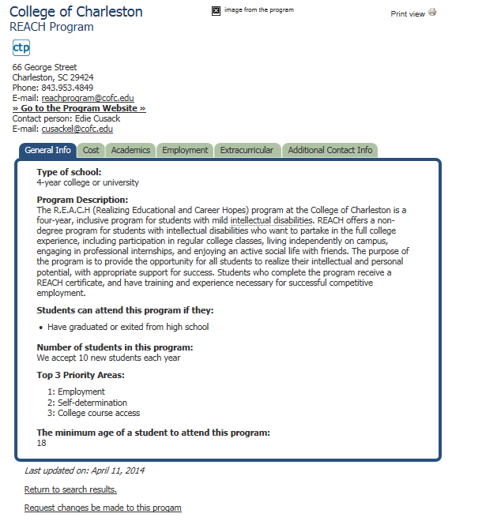
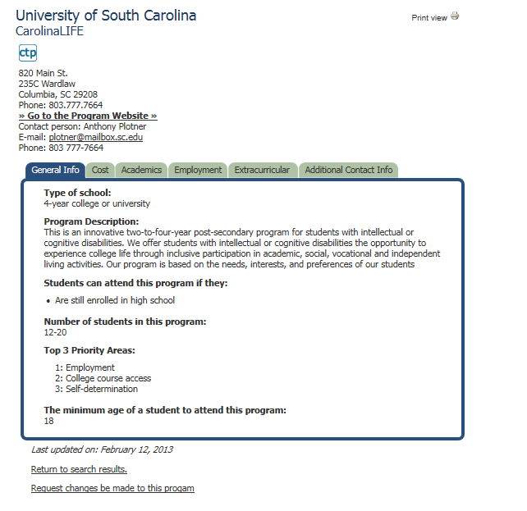
A look at 2 Inclusive Colleges in SC

Slide 38
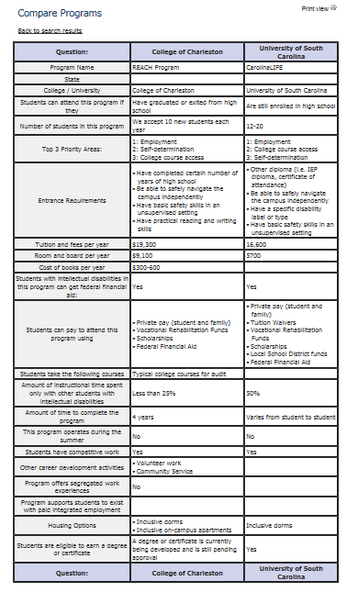
Comparing Colleges

Slide 39
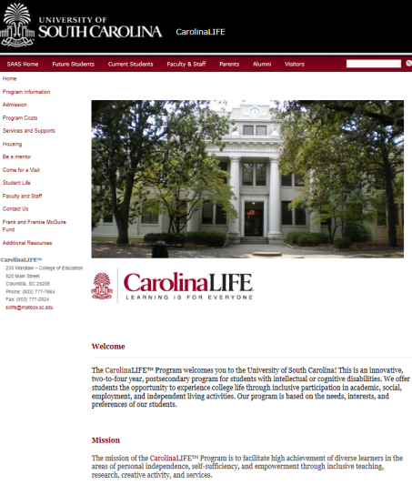
CarolinaLIFE

Slide 40
Transition Success: Understanding the Self‐Advocacy & AT Connection

Slide 41
Transition Success: Consider this
Our Success relies on
Knowing Myself
Self-Exploration
Who Are You?
Learning Style
What is Your Learning Style?
Honestly Exploring –
What do I want to Do When I Grow Up?
What Assistive Technology do I need to accomplish my Goals?

Slide 42
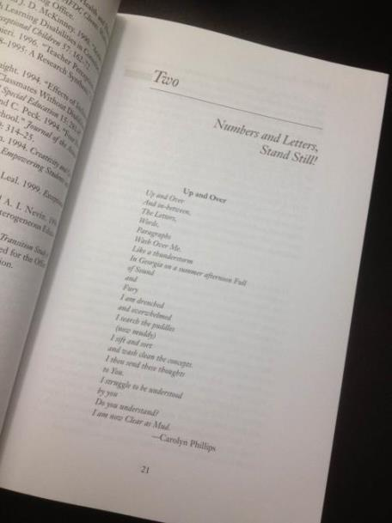
Poem

Slide 43
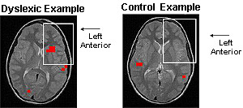
The Neurology of My Brain
The “rate” at which you learn will become the only sustainable competition advantage you’ll have in your life.
- Peter Senge
Visual Perception & Discrimination
Auditory Perception & Discrimination

Slide 44
Carolyn’s Specific Learning Disabilities
Dyslexia - Difficulties with learning to translate printed words into spoken words with ease
Dysgraphia - Deficits in writing (organization, clarity, unity, mechanical errors, spelling, handwriting)
Dyscalculia - Difficulty with numbers and/or remembering facts over a long period of time (columns, number reversal, mathematical operation)

Slide 45
More on Carolyn’s Specific Learning Disabilities
Auditory Perceptual Deficit
Has trouble receiving accurate information from the sense of hearing (trouble with how the brain interprets what it hears) - oral instructions, differentiating between similar sounds, hearing one sound over a background of other noise

Slide 46
More on Liz’s Specific Disability
What is Spinal Muscular Atrophy Type 2?
Spinal muscular atrophy (SMA) is a genetic condition which affects the nerves that control muscle movement – the motor neurons.
It is named 'spinal' because most of the motor neurons are located in the spinal cord. 'Muscular' is in the name because it primary affects the muscles which don’t receive signals from the motor neurons. ‘Atrophy’ is the medical term for wasting away or getting smaller, which is what generally happens to muscles when they’re not active.
Weakness of the spinal muscles results in scoliosis (curvature of the spine) which may require bracing and eventually surgery. Shortening of the muscle (contractures) can restrict movement especially around the hip, knee and ankle joints. Usually the muscles used in chewing and swallowing are not significantly affected early on. The muscles of the chest wall are affected, causing poor breathing function and susceptibility to respiratory infections and complications.
Notes:
Liz

Slide 47
Liz’s Specific Disability
Muscular Dystrophy
Spinal Muscular Atrophy 2
Diagnosed at 9 months
Life Expectancy? (Age 2, 7, 11, 17) I AM 36!!
Stable vs. Decline
Progressive Muscle Weakness
Fatigue
Chronic Pain
Variety of assistive technology and durable medical equipment - writing, access, environment
My list of AT & DME continually grows!
Notes:
Liz

Slide 48
Transition Success: Understanding the Assistive Technology Connection

Slide 49
Why Assistive Technology?
For a person without a disability, technology makes things easier….
For a person with a disability, technology makes things possible.
TIP: USE AT. I have yet to meet a successful student who doesn’t use Any AT.

Slide 50
Universal Design for Learning & Differentiation
"Research indicates that many of the emotional or social difficulties gifted students experience disappear when their educational climates are adapted to their level and pace of learning."
TIP: Differentiation in education can also include how a student shows that they have mastery of a concept. This could be through a research paper, role play, podcast, diagram, poster, etc.
TIP: The key to differentiation is finding how your students learn and displays their learning that meets their specific needs.
Wikipedia

Slide 51
Consider this
Our Success relies on
Failing
Dignity of Failure
I learned More from My “Failures” sometimes than my “successes”
Give yourself room to fail – and Grow from the experience
Learn to Laugh - a lot!
Be Optimistic
Evaluate & Evolve!

Slide 52
Moving from Information to Action
Educational Psychological Evaluations
One to one assessment
Comprehensive battery of tests
Detailed report with recommendations for support in work and/or learning
What did You learn in your Evaluation?
Moving from Information to Action
Using your Evaluation results as an Action Plan for AT

Slide 53
The “FAST” Track
Frustration
Anxiety
Stress
Tension

Slide 54
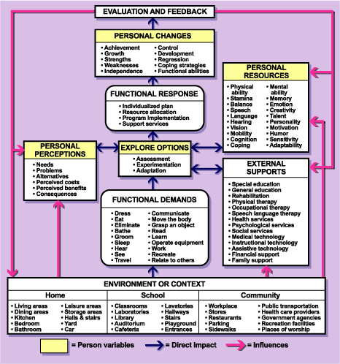
Enhancing All of Life’s Functions
Considering AT:
Identify Environments
Determine the Functional Areas
Select AT
Dr. Cheryl Wissick and
Dr. Elizabeth Bagley

Slide 55
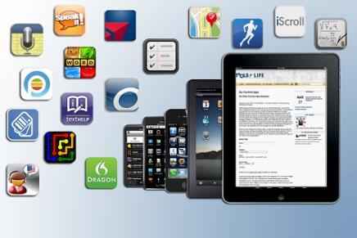
Smooth Transitions: Making Informed Decisions

Slide 56
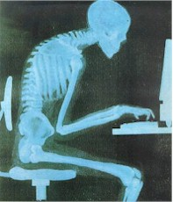
Ergonomics
Inhibits blood flow
Creates muscle shortening
Stresses back muscles and compresses spine
Can inhibit learning
Compresses diaphragm
Affects breathing
Voice quality

Slide 57
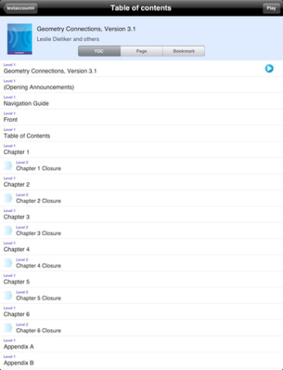
Learning Ally
Learning Ally
DAISY
Membership required
over 75,000 audiobooks, audio textbooks, and other recorded books
Free Trial
Notes:
CL

Slide 58
Bookshare
Online Accessible Library
Free membership to qualified students and schools
Textbooks if school is member
208,769 titles
Serves individuals with:
Vision disabilities
Physical disabilities
Learning disabilities

Slide 59
Audible.com
Digital audiobooks
Read by Hollywood stars, authors, and professional narrators
Listen anywhere
Over 150,000 titles
Membership
$14.95/ month for one book

Slide 60
ClaroSpeak US
Text-to-Speech
import documents and PDFs into ClaroSpeak from apps such as Mail, or import PDF, Word, Pages and other files directly from Dropbox using
Change font and color
Save text as an audio file
Visual Tracking
Send Text
Notes:
MR

Slide 61
ClaroRead
Reads text as it highlights
Moveable tool bar
Can read doc, PDFs, internet, and more
6.2 version
In Europe
Save directly to iTunes
Create a video
Change highlight colors
www.claroread.com

Slide 62
TextHelp
Text-to- Speech software
Helps improves reading skills
Built in text and picture dictionaries
Study skills highlighter
Google Chrome version
www.texthelp.com

Slide 63
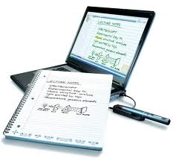
Live Scribe Pen
Records what it hears and what you write
Uses specific paper for playback
Connects to computer by USB for saving
Tap on note and playback from there
Jump forward and back in notes
Dictionary
Translation Apps
Purchase Apps online
Demo

Slide 64
Speech Recognition Software
Turn spoken words into text
Connect with the timing of your thoughts
Dictation speed 70 to 100 words per minute

Slide 65
Ginger
Online grammar and spell checker
Can see corrections as you type or use Ginger Proofreader to scan the entire document for mistakes
Will read corrections out loud
Has an mobile Android app
Works inside Word and emails
Text to Speech
Read emails and docs
Can choose voice and accent
Ginger Demo

Slide 66
Inspiration
Mind Mapping software
Allows User to “connect” ideas together
Add in pictures and hyperlinks
Can produce an outline form
Better organization of essays
$39.95
App $9.99

Slide 67
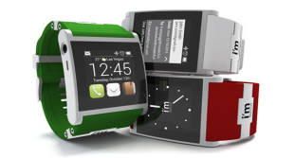
Tracking Trends
Increase in Universal Design in Mainstream
Schools incorporate “Bring Your Own Technology”
Customized reading levels
Convergence
The Future is Contextual
GPS in technology
Ads on Internet
Social Media

Slide 68
Google Now

Slide 69
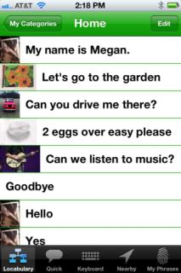
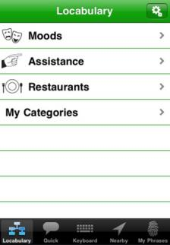
Locabulary
Uses GPS to track user location and suggests appropriate vocabulary based on location
ie: Starbucks
A keyboard to type for text-to-speech
User can tag their own locations and create vocabulary for each location
Lite version Free; Pro version $130

Slide 70
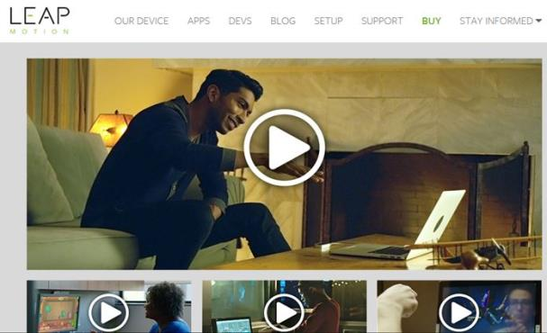
LEAP Computer Input

Slide 71
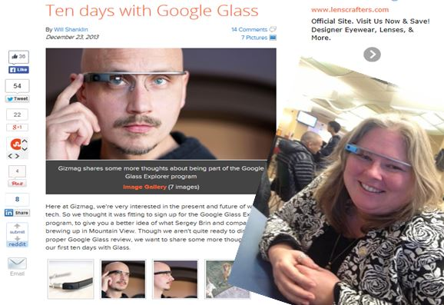
Google Glass

Slide 72
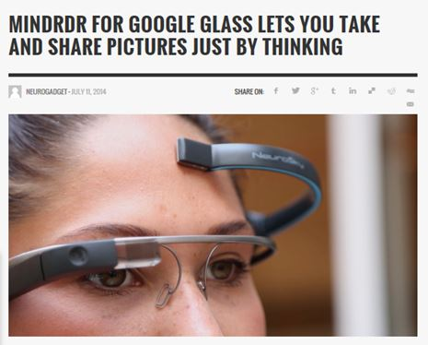
Mindrdr for Google Glass

Slide 73
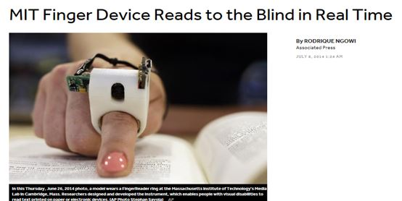
Reading Finger Device

Slide 74
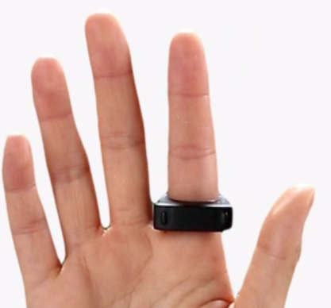
Nod
Controls devices remotely
Change presentation slides
Type notes
Environmental Control Units
$149, Early 2015
https://hellonod.com

Slide 75
VGo Telepresence Robot
Enables individuals to replicate themselves in a distant location and have the freedom to move around as if they were physically there
Reduces travel costs
School
Hospital
Work from home

Slide 76
Successful Transitions Help Create a Successful Life Journey
Teach Students to:
Get to Know Yourself
Plan for Your Success – in school, work, Life!
Begin with the End in Mind
Be able to tell Your Story
Listen & Learn
Try – Fail & Try again…
When things get off track - Evaluate and Evolve
Explore & USE Assistive Technology
Laugh Much!
Celebrate your Successes!!

Slide 77
Transition Success
Our Success relies on
Building win-win-WIN relationships
Establishing a solid circle of support
Receiving and providing support
Diversify your Circle of Friends and Acquaintances
It sometimes is “Who you know”
BALANCE - Social Life and Studies

Slide 78
Questions?

Slide 79
Webinar Evaluation
At the end of today’s webinar, we ask that you please take a moment to complete our survey:
https://www.research.net/s/TFLwebinar

Slide 80
The TFL Team
Carolyn Phillips
Director, Tools for Life
Carolyn.Phillips@gatfl.gatech.edu
Daphne Brookins
AT Funding & Resource Specialist
Daphne.Brookins@gatfl.gatech.edu
Ben Jacobs
Accommodations Specialist
Ben.Jacobs@gatfl.gatech.edu
Liz Persaud
Training and Outreach Coordinator
Liz.Persaud@gatfl.gatech.edu
Martha Rust
AT Specialist
Martha.Rust@gatfl.gatech.edu
Rachel Wilson
Tech Match Specialist
Rachel.Wilson@gatfl.gatech.edu
Disclaimer
This presentation is produced by Tools for Life which is a result of the Assistive Technology Act of 1998, as amended in 2004. It is a program of the Georgia Institute of Technology, College of Architecture [COA], AMAC and is funded by grant #H224C030009 of the Rehabilitation Services Administration (RSA), Department of Education. The contents of this presentation were developed under a grant from the Department of Education. However, those contents do not necessarily represent the policy of the Department of Education, Georgia Tech, COA or AMAC and you should not assume endorsement by the Federal government.

