Slide 1
Session Code: ATIF021 Here’s Hope: Assistive Technology Supporting Mental Health
Curt Johnson, M.S., CRC, ATP
University of Washington Medical Center
Cinda Johnson , Ed.D.
Seattle University
Carolyn P. Phillips, M.Ed., ATP
Director, Tools for Life
Maria Kelley, OTR/L, ATP
Washington Assistive Technology Act Program
January 30, 2015 1:00 – 2:00

Slide 2
Learning Objectives
Identify 3 AT solutions used during the educational planning process
Identify 3 AT approaches to avoid the “FAST” track
Identify 3 AT solutions to support or accommodate individuals with mental health issues at work

Slide 3
Assistive Technology (AT) Is Most Frequently Associated With:
Physical Disabilities
Communication Disorders
Vision Loss
Learning Disorders
Hearing Loss

Slide 4
Mental Health Technologies
Soothers / Comforters - (Anxiety)
Distracters / Disrupters - (Agitation)
Reminders / Schedulers - (Memory)
Safety / Monitoring - (Risk Behaviors)
Mood Trackers / Screeners - (Therapeutic)

Slide 5
THE FACTS !!!
One out of four American families has a relative who has a mental illness or about 57.7 million Americans diagnosed per year.
Mental illness typically strikes young people in their most productive years, 16-25.
WHO reports that 4 of the 10 leading causes of disability are mental disorders
Mental illness costs the US $444 billion/year - mainly lost wages
With proper Diagnosis, Medications and Therapies 70%-90% of individuals have reduced symptoms and better quality of life.

Slide 6
Sampling of Student/Worker Traits Impacted by Mental Illness
Concentration
Depression or Racing Thoughts
Fatigue
Memory / Organization
Medication Side Effects
Treatment Residual - ECT
Inconsistency
Mood Changes
Decision Making Skills
Unpredictability
Agitation
Risky Behavior

Slide 7
AT as a Supplement to Treatment
Digital Hand Held Devices
Smart Phones, Pagers, Watches
Tablets, Computers, Sound Machines
Video Conferencing, Social Networking, Sleep Aids
Apps, On-line or On-Board Accessibility Software
Commercial Apps, Text Reader, Color Options
Low Tech
Ear Buds, Pocket Stone, Note Pads, Service Animal

Slide 8
On-line or Device Trackers
Graph moods over time making it easy for the individual or their therapist to track daily rhythms
Important to use secure and encrypted online tools when sharing data with family, providers or certified peer specialists
Your phone “reminds” you to complete daily input
Supplemental Tracking of:
Medications taken
Exercise completed
Food eaten

Slide 9
DBSA Wellness Tracker www.DBSAlliance.org/Tracker On-line - iOS App - Android App
Provides key health trends for mood disorder
Overall Mood – (depressed to manic)
Well-Being – (cheerful, calm, active, rested)
Mood Disorder Symptoms – (rate and comment)
Lifestyle (including sleep, exercise, etc.)
Medication and Side Effects
Physical Health

Slide 10
Emerging Technology
Devices that Monitor – Breathing, Heart Rate, Voice Pattern Changes
Auto Texting to or from Consumers to their Therapist or Health Care Facility
Virtual Reality Treatments – PTSD
provides real world environments during exposure therapy

Slide 11
Cinda Johnson cinda@seattleu.edu
Barriers created by mental illnesses in education
Early indicators, planning, implementation, reporting
Examples of AT in education

Slide 12
A Quick Overview
One in 5 children and adolescents have some type of mental, behavioral or emotional problem; one in 10 are significant issues.
One in 8 adolescents have depression.
Suicide is the third leading cause of death among young people 15 – 24.

Slide 13
Barriers
Only 30% of students struggling with these issues receive treatment.
Fewer than half of students with mental health conditions complete high school (40%).
Employment is consistently less robust than peers without mental health conditions.
Homelessness and arrests are high.
Notes:
Linea

Slide 14
What you should know:
Educators and families must work together to recognize the symptoms and know the next steps (refer!)
Functional Behavior Assessments (FBA) are necessary and required
Behavior Intervention Plans (BIP) are part of the Individualized Education Program (IEP)
Behavior plans typically used for overt behaviors with over-representation by males and students of color.

Slide 15
Examples of Interventions in the Schools
“Check in” for positive behavior
Catch them on their best behavior!
Self monitoring
Video prompting
Cognitive behavior therapy
Cooling down and mindfulness practice

Slide 16
Behavior Trackers
Easy Behavior Tracker for Teachers (1.99)
Autism Tracker Lite: Track analyze and share ASD daily (free)
Group Star Charts (.99)
Social Stories for Problem Behaviors (9.99)
Calm Counter
Wait Timer
Turn Taker
Going Shopping
Running (when and where to run)

Slide 17
Self Monitoring
Student identifies and monitors her or his own behavior. Age and developmentally appropriate.
Excel!
Modeling Boundaries
Calm Counter

Slide 18
Video Prompting & Modeling
Videos that show a task in the setting in which it occurs
Student is recorded doing his or her best performance
Used in transitioning activities, school to work activities, daily living skills, social skills
“Make New Friends in Middle School” https://www.youtube.com/watch?v=MJYLfekgw2I

Slide 19
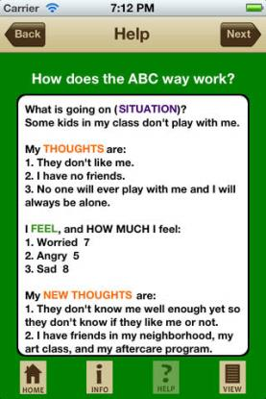
Cognitive Behavior Therapy
CBT4Kids Toolbox (free)
DBT Emotion Regulation Tools (7.99)
Kid CBT ABC
https://itunes.apple.com/us/app/kid-cbt*abc-way/id552651162?mt=8

Slide 20
Mindfulness
Class or individual “breathing break”.
Tips for Teaching Mindfulness to Kids
Relax Sounds – Relaxing Nature & Ambient Melodies (free)
Take a Break! –Guided Meditation (free)
Stop, Breathe & Think (free)
Relaxing Sounds & Ambient Music for Sleep, Meditation, Yoga ($2.00)

Slide 21
The “FAST” Track
Frustration
Anxiety
Stress
Tension

Slide 22
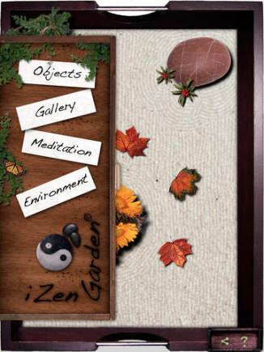
Considering No/Low Tech to High Tech

Slide 23
Reduce Stress
“The survey found that women who frequently use social media, along with other technologies, to connect with friends and family report feeling less stressed than women who connect less often.
The researchers at Rutgers University in New Jersey and the Pew Research Center in Washington, D.C., found that women who frequently email, text and use social media scored 21 percent lower on a test that measures stress than women who don't use these technologies”
- Elizabeth Palermo, LiveScience Published: 01/15/2015 10:56 AM EST on LiveScience

Slide 24
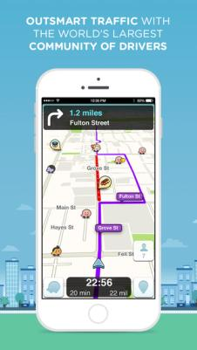
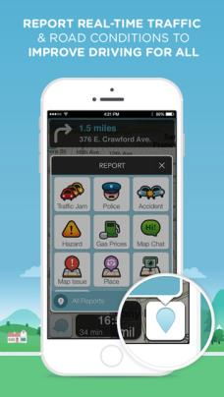
WAZE
FREE!
iOS
Waze is the world's largest community-based traffic and navigation app. Join drivers in your area who share real-time traffic & road info to save time, gas money, and improve daily commuting for all.

Slide 25
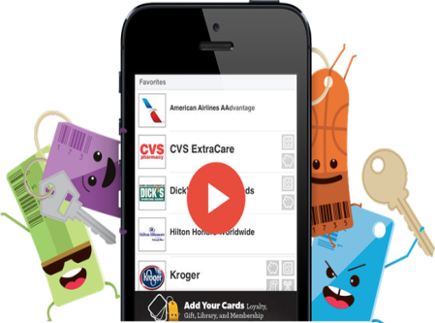
Key Ring App
FREE!
iOS and Android
All those loyalty cards are hard to keep track of. Key Ring puts all your cards on your phone, so they’re there when you need them. Scan and store grocery cards, gym cards, library cards, gift cards... you name it. Loyalty cards scan straight from your phone at the checkout counter, saving you money instantly

Slide 26
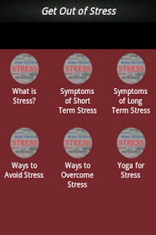
Get Out of Stress
FREE!
Android
Modern life is full of deadlines, frustrations, and demands. For many people, stress is so commonplace that it has become a way of life. You can protect yourself by recognizing the signs and symptoms of stress and taking steps to reduce its harmful effects. This Application gives you complete idea about Stress , its symptoms and stress management in simple and efficient way. The Application Includes ** What is stress ** Symptoms of short term stress ** Symptoms of longterm stress ** Ways to avoid stress ** Ways to overcome Stress ** Yoga for Stress

Slide 27
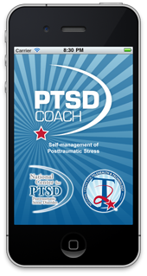
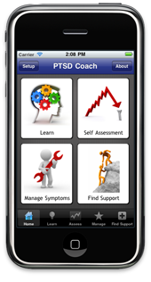
PTSD Coach
FREE!
Android & iOS
PTSD Coach was designed for Veterans and military Service Members who have, or may have, Posttraumatic Stress Disorder (PTSD). This app provides users with education about PTSD, information about professional care, a self-assessment for PTSD, opportunities to find support, and tools that can help users manage the stresses of daily life with PTSD. Tools range from relaxation skills and positive self-talk to anger management and other common self-help strategies. Users can customize tools based on their preferences and can integrate their own contacts, photos, and music. This app can be used by people who are in treatment as well as those who are 0t. PTSD Coach was created by VA

Slide 28
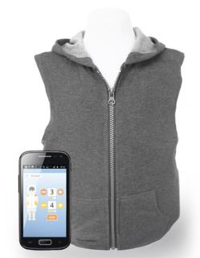
AT for Calming
T. Jacket by T. Ware
Wearable technology
Provides deep touch pressure to calm/soothe individual who is anxious or stressed
Pressure controlled via smartphone iOS or Android
Child/Adult sizes; $599

Slide 29
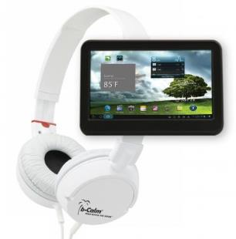
AT for Calming
b-Calm
Products for adult and children ( $109 -$205)
Preloaded audio sedation tracks
Acoustic masking signals work to make typically distracting noises unapparent to the user
Audio recordings to help with relaxation and focus

Slide 30
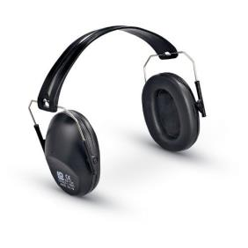
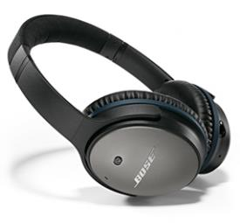
Modifications to the work environment
Provide private office or work area with limited distractions/low traffic area
Noise reducing headsets/ noise reduction ear muffs
Can decrease help to reduce stress and improve concentration
Can also reduce ambient noise at night and help with sleep

Slide 31
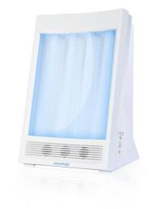
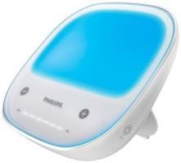
Modifications to the work environment
Provide natural light or therapy lamps
Simulate outdoor lighting
Many options…make sure designed for SAD
Light box should emit reduced UV light
Brightness will affect hours of use; consult healthcare provider for hours of use
Recommended distance 2 feet from user
Source: mayclinic.org

Slide 32
APPS for Mood/Emotion Management
Operation Reach Out (free iOS, Android)
Developed by military to prevent suicide
Helps access thinking and when to reach out for help when in crisis
T2 Mood Tracker (free iOS, Android)
Allows users to monitor moods on pre-loaded scales
MindShift (free iOS, Android)
Tools for relaxation; develops new thinking; suggests healthy activities
Breathe2Relax(free iOS, Android)
Uses guided breathing exercises to reduce anxiety

Slide 33
T2 Mood Tracker
FREE!
iOS
T2 Mood Tracker allows users to monitor their moods on six pre-loaded scales (anxiety, stress, depression, brain injury, post-traumatic stress, general well-being). Custom scales can also be built. Users rate their moods by swiping a small bar to the left or to the right. The ratings are displayed on graphs to help users track their moods over time. Notes can be recorded to document daily events, medication changes and treatments that may be associated with mood changes, providing accurate information to help health care providers make treatment decisions.

Slide 34
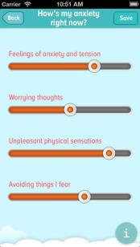
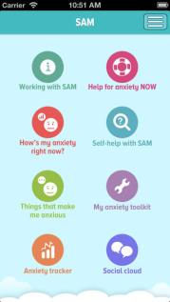
APPS for Mood/Emotion Management
Self-Help for Anxiety Management(SAM) (free iOS, Android)
Tell the app how you’re feeling, how anxious you are, or how worried you are.
app’s self-help features walk you through some calming or relaxation practices.
iZen garden ($4.99, iOS)
Koi Pond ($1, iOS)

Slide 35
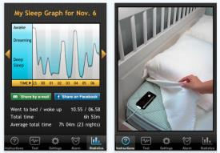
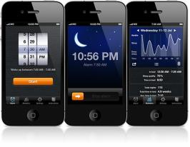
APPS for Sleep Management
Monitors sleep habits
Uses accelerometer in the smartphone, tells you how quickly you fall to sleep, when you enter each phase of sleep, and how efficient each sleep cycle is. The app gently wakes you up at the right time, not in the middle of a deep sleep
Sleep Time-Alarm Clock (free, iOS, Android)
Sleep Cycle ($1, iOS, Android)
Sleepbot ( free, iOS, Android)

Slide 36
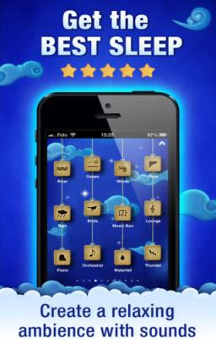
Relax Melodies: Sleep & Yoga
FREE!
iOS and Android
Relax Melodies is the LEADER in personalized relaxation and sleep assistance. No more lacking of sleep or insomnia for you! The sleep that you need and want is waiting for you. Relax Melodies and its many features such as high quality white noise sounds, music melodies and complete customizable mixes will help you sleep like never before!
Here’s how it works :
1. Create a sleep mix by selecting sounds and music that you like. 2. Slip naturally into a relaxed state or a deep sleep...! 3. Awake, feel refreshed and happier 4. Do it again, anytime!
Use it also in many other situation such as while exercising, during your yoga meditation sessions, while massaging, during a quick nap or even to help your baby fall asleep faster!

Slide 37
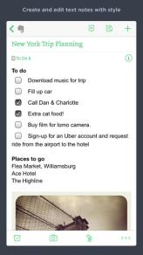
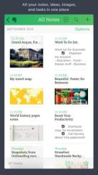
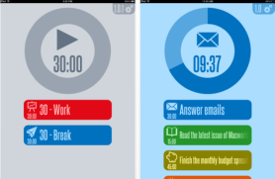
APPS for task management
Evernote (free, iOS, Android, Windows)
allows you to store text, photos, and audio notes on your device of choice. Create "notebooks" and categorize notes for meetings and to-do lists. Notes are tagged with geo-location for mapping or search. Keep all info in one place
30/30 (free, iOS, Android, Windows)
Set up tasks and time needed to complete
App will tell you when to move onto next task

Slide 38
App Search Engines
Tools for Life-App Finder http://www.gatfl.org/favorite-search.php
Bridging APPS
http://bridgingapps.org/
Appcrawlr
http://appcrawlr.com/

Slide 39
Organizations
Depression and Bipolar Support Alliance (DBSA) www.dbsa.org and www.FacingUs.org
National Alliance on Mental Illness (NAMI)

Slide 40
Categories of Mental Illness
Diagnostic and Statistical Manual of Mental Disorders (DSM – 5)
Lists 16 Categories of Mental Disorders
Todays presentation focused on 3 areas
Mood Disorders
Anxiety Disorders
Personality Disorders
Most common student/worker diagnosis may include:
depression, schizophrenia, bipolar disorder, obsessive compulsive disorder (OCD), anxiety/panic disorder, post traumatic stress disorder (PTSD) and borderline personality disorder

Slide 41
Thank you for attending this session
CEUs – Session Code: ATIF-021
More info at: www.atia.org/CEU
For ACVREP, AOTA and ASHA CEUs, hand in completed Attendance Forms to REGISTRATION DESK at the end of the conference. Please note there is a $15 fee for AOTA CEUs.
For general CEUs, apply online with The AAC Institute: www.aacinstitute.org
Session Evaluation: URL
Please help us improve the quality of our conference by completing your session evaluation form.
Completed evaluation forms should be submitted as you exit or to staff at the registration desk.
Handouts
Handouts are available at: www.atia.org/orlandohandouts
Handout link remains live for 3 months after the conference ends.

