Slide 1
Wearable Technologies: What are they and how can they assist someone with a Disability GATE 2016 Martha Rust and Asha Kumar with contributions by TFL Team www.gatfl.gatech.edu

Slide 2
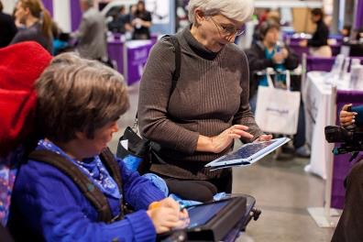
Tools for Life Mission
Tools for Life, Georgia's Assistive Technology Act Program, is dedicated to increasing access to and acquisition of assistive technology (AT) devices and services for Georgians of all ages and disabilities so they can live, learn, work and play independently and with greater freedom in communities of their choice.

Slide 3
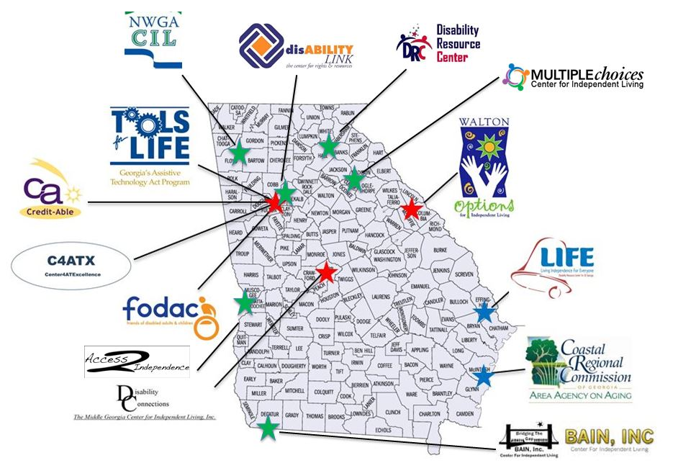
The TFL Network

Slide 4
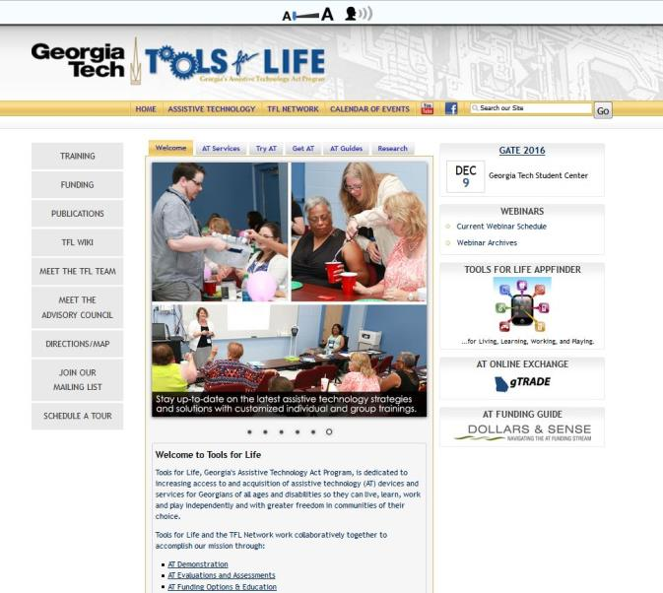
Visit us online!

Slide 5
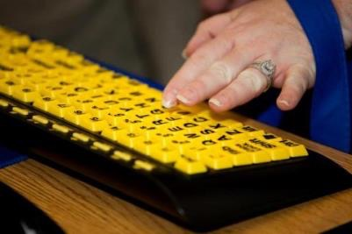
What is Assistive Technology?
Assistive Technology (AT) is any item or piece of equipment that is used to increase, maintain or improve the functional capabilities of individuals with disabilities in all aspects of life, including at school, at work, at home and in the community.
Assistive Technology ranges from no/low/light tech to high tech devices or equipment.

Slide 6
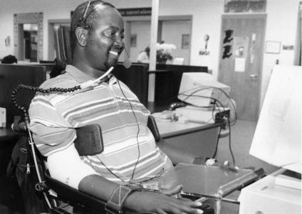
Why Assistive Technology?
For a person without a disability, technology makes life easier.
For a person with a disability, technology makes life possible.
TIP: USE AT! We have yet to meet a successful individual who does not use any AT.

Slide 7
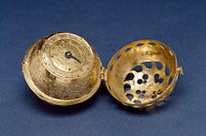
Wearable Facts
Invention of the first wearable device can be traced to the creation of the portable watch in the 16th century
In 1979 Sony invented the Walkman
In 2000, the first Bluetooth headset was sold
2004, the first GoPro was launched
Google Glass released in 2013
ABI Research estimates the global market for wearables in health and fitness could reach 170 million devices by 2017
Global wearables market is expected to reach a value of 19 billion U.S. dollars in 2018

Slide 8
Wearables!
Nokia has been developing magnetic or vibrating tattoos that can alert the user when there is an incoming call or a warning alert for a dead battery from a mobile phone
Remote Brain Machine Interface (RBMI) can be defined as a means to control a machine that is in a different geographical location than the user
Increase of using wearable in the aging population
Increase of using wearable technologies for people with disabilities

Slide 9
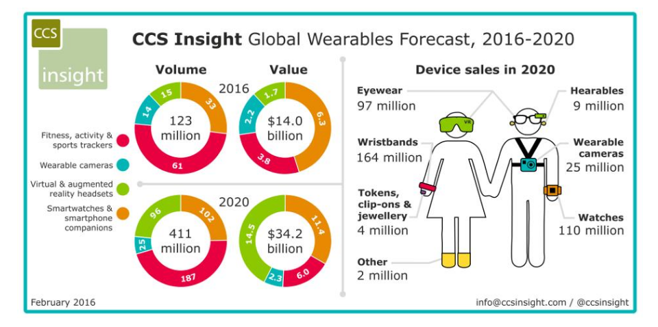
CCS Insight Global Wearables Forecast

Slide 10
Wearable Jewelry

Slide 11
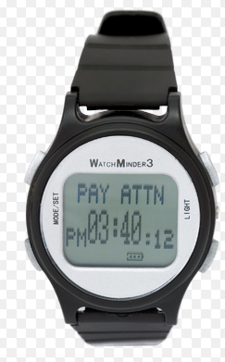
Watchminder
Rechargeable battery
65 pre-programmed messages to chose from
30 daily recurring alarms
Create your own personalized messages
Helpful training and reminder modes
Vibrating alert

Slide 12
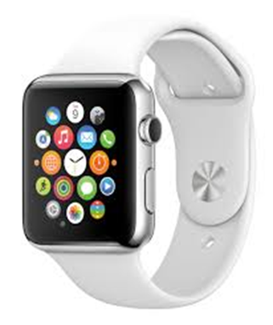
Apple Watch
Receive Calls and texts
“Inner Circle”
Apps
Can be used for fitness
Heart Rate Monitor
GPS
Accelerometer
“Hey Siri”
Haptic feed back
Calendar
$499

Slide 13
Neutun
Makes it easy to track, manage and live with epilepsy
App for Smart Watches
Useful for:
Medication Management
Care Circle
Health Insights
Log Seizures

Slide 14
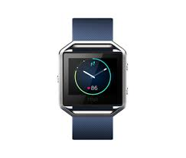
FitBit
Fitness tracker
Variety of styles and colors
Track Activity
Track Food
Track Sleep
Track Heart rate
Works with other Apps
New Smartwatch

Slide 15
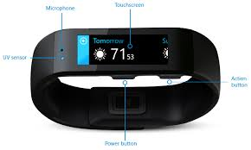
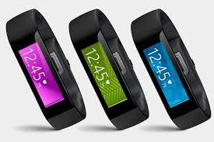
Microsoft Band
Works across all platforms
Receives calls and texts
Uses Cortana
Keep tracks of steps
Keeps track of Sleep
Keeps track of UV
Keeps track of heart rate
Choose apps
Facebook
$199

Slide 16
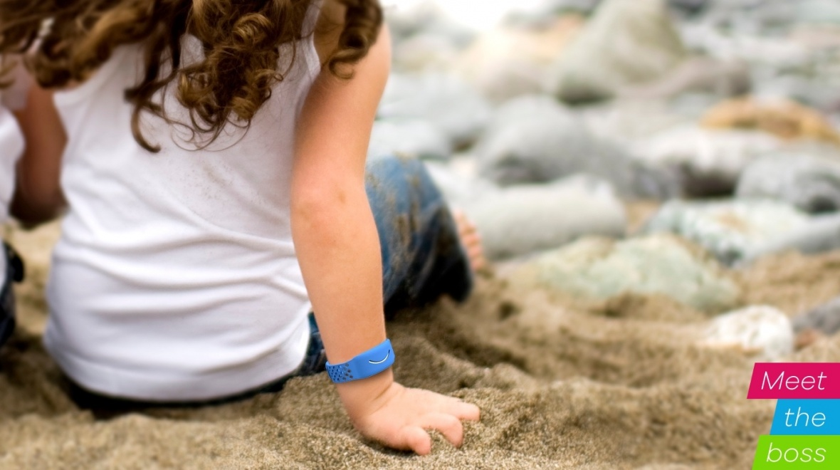
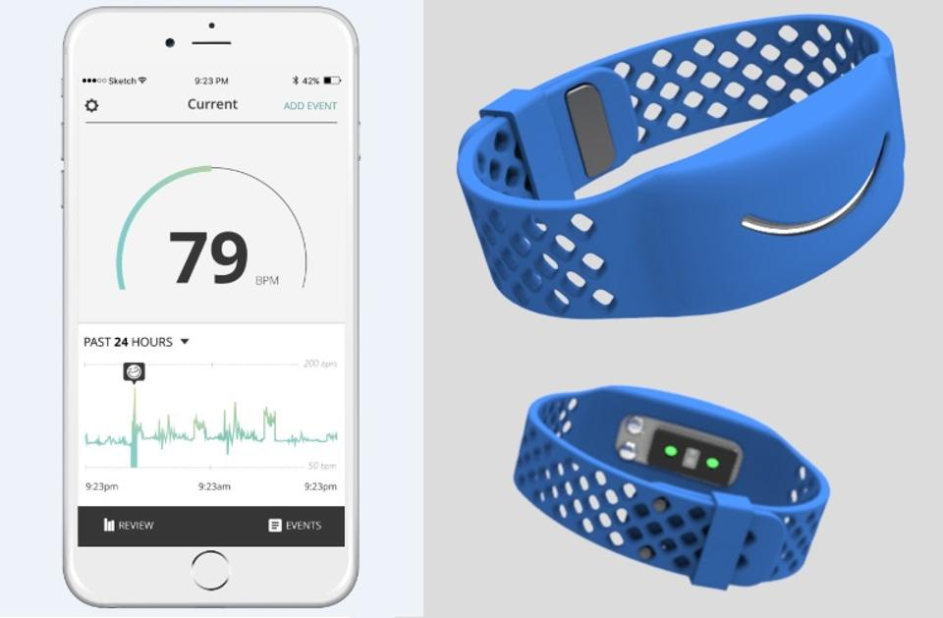
Reveal
Measures and tracks anxiety to help you better understand behavior and prevent meltdowns.

Slide 17
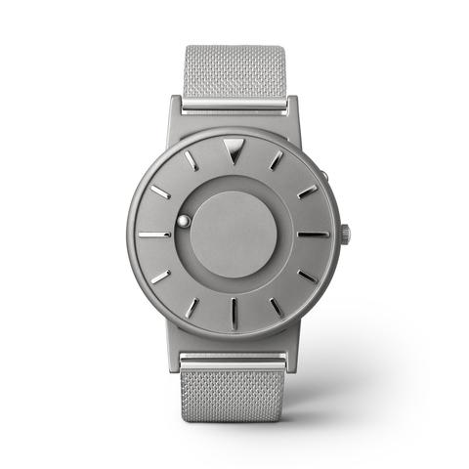
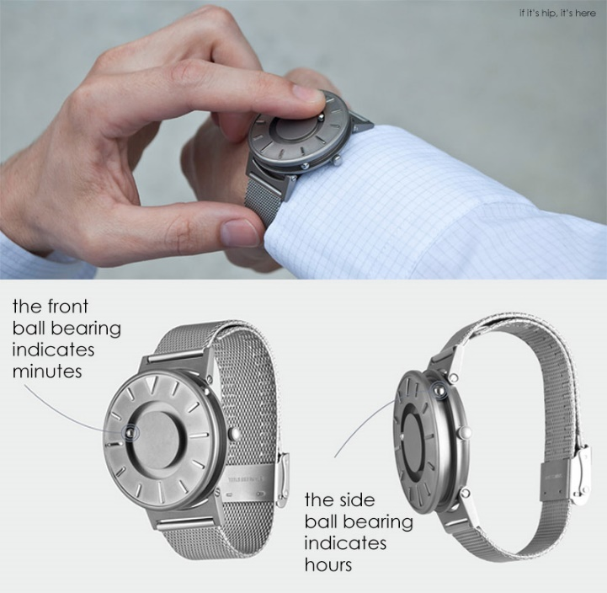
The Bradley
A fashion timepiece, designed in collaboration with the vision impaired, that you can touch and see to check time.
Instead of traditional watch hands, time is indicated by two ball bearings (connected by magnets to a watch movement beneath the watch face)–one indicating minutes (top) and one indicating hours (side). Even if the ball bearings are displaced when touched, the magnets will move the bearings back to the correct time with a gentle shake of the wrist.”

Slide 18
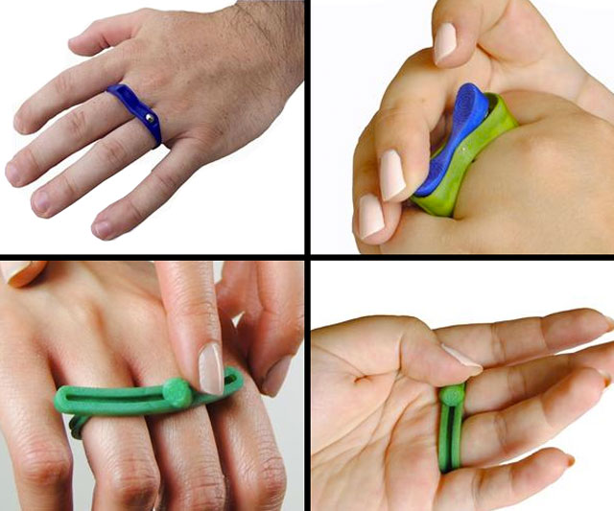
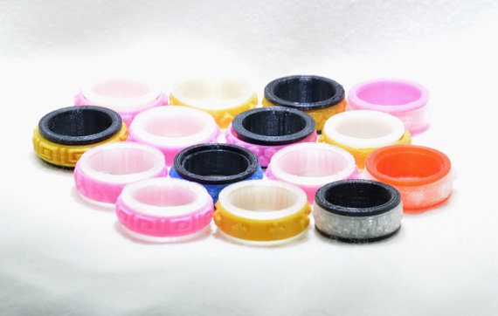
Fidget Ring
Similar to fidget toys; except you can wear them!
Helps for people who are anxious or have trouble focusing on the something.

Slide 19
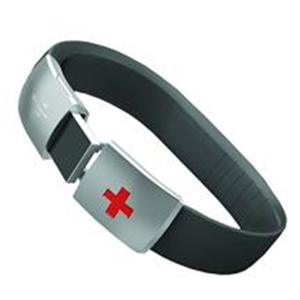
EpicID Emergency ID Band
Easy for first responders to access
Salt water safe USB with a durable stainless steel clasp and USB cover
No subscription or internet connection is required
Plug this USB into your computer and input or update your personal information medical history and insurance information
Both PC and Mac compatible

Slide 20
Wearable Calming

Slide 21
B-Calm
“acoustic shield”, allowing the individual to have control of the sound environment
helps reduce off task behaviors and irritability
disturbing noises are blocked and replaced with familiar and soothing sounds

Slide 22
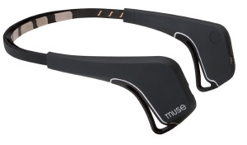
Muse: The Brain Sensing Headband
Put on the Muse headband, put on your earbuds, start the app, and close your eyes. Immerse yourself within the sounds of a beach or rainforest.
While you meditate, it measures whether your mind is calm or active, and translates that data into weathers sounds.
When you're calm, you'll hear peaceful weather sounds. When your mind wanders, the weather will intensify, guiding you back to a calm state.

Slide 23
Wearable Clothing

Slide 24
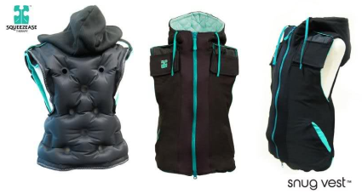
Snug Vest
inflates to provide adjustable and evenly-distributed pressure to the torso for a comforting hug-like squeeze without pressure placed on the stomach or chest.
promotes independence as the user can self-inflate their vest in a discrete way to get the exact amount of safe pressure they need. Snug Vest enables the user to complete daily tasks with ease anywhere they go!

Slide 25
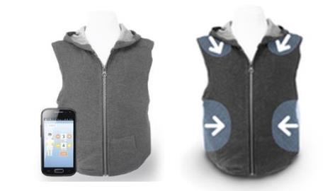
T. Jacket
Wearable technology vest
Provides customizable deep touch pressure
Uses adjustable air pressure compression controlled via smartphone app
http://www.mytjacket.com/

Slide 26
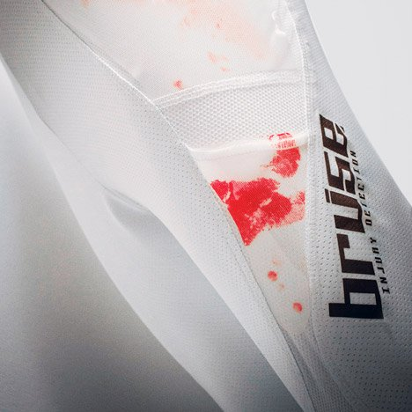
The Bruise Suit
Smart injury detection suit for disabled athletes with loss of sensation.
It applies a recyclable pressure-sensitive film to indicate the severity of injuries. High risk areas are covered with disposable, made-to-fit film sheet inserts.
If an area is excessively stressed during an accident, the film will irreversibly change color. After training or competing, injured areas can be easily spotted and effectively treated.”

Slide 27
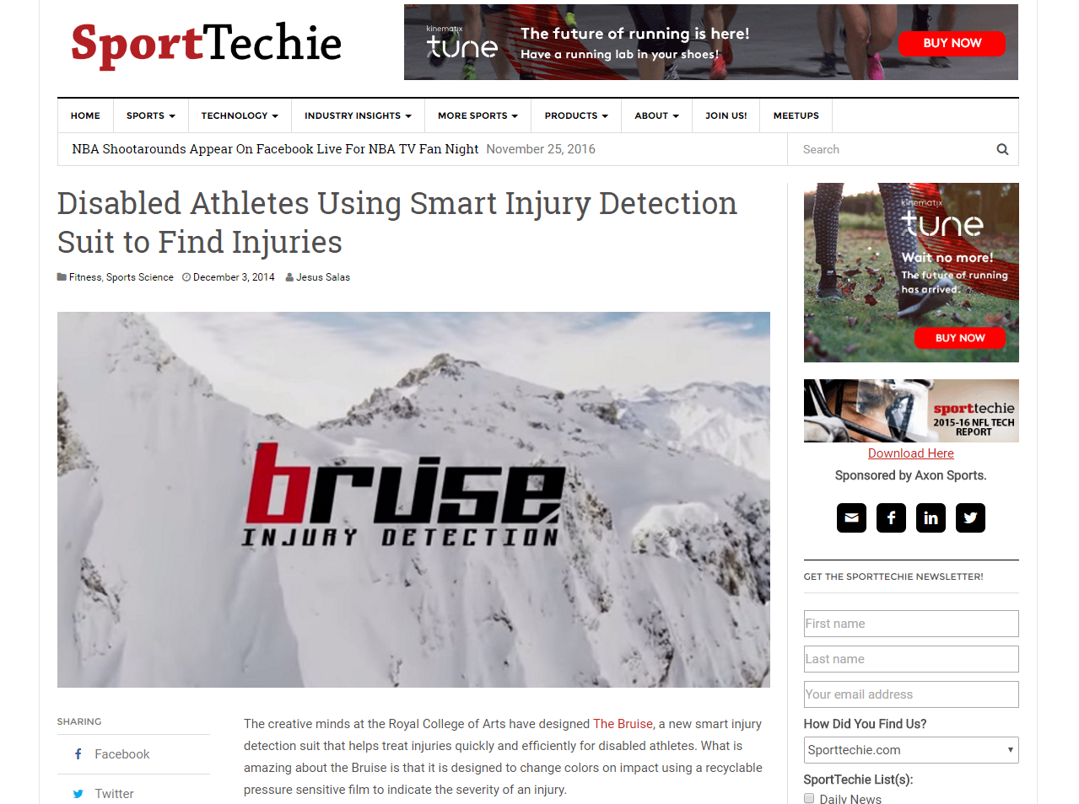
SportTechie article

Slide 28
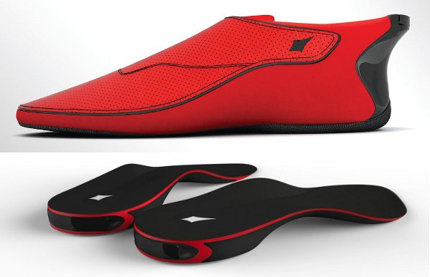
Lechal
Haptic Footwear
Uses GPS to let you know where you are
Connects with app
www.lechal.com

Slide 29
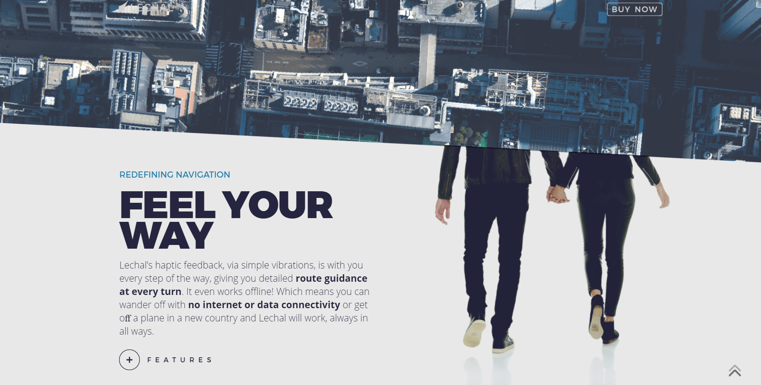
Lechal Images

Slide 30
Wearable Seeing and Hearing

Slide 31
OrCam Sreenshot

Slide 32
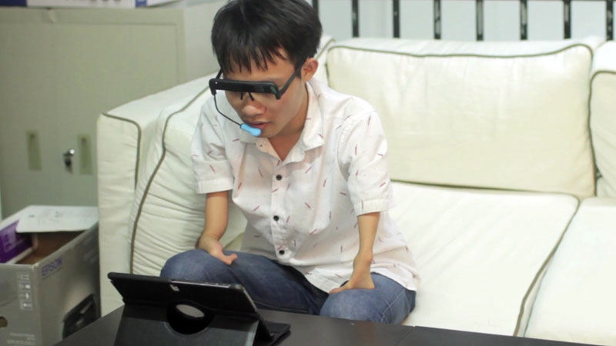
GlassOuse
Helps people control electronics without using their hands.
Based on your head movements, it moves the cursor onscreen. You bite on a blue extension to click, and it can go a week without charging.”
https://vimeo.com/158593763

Slide 33
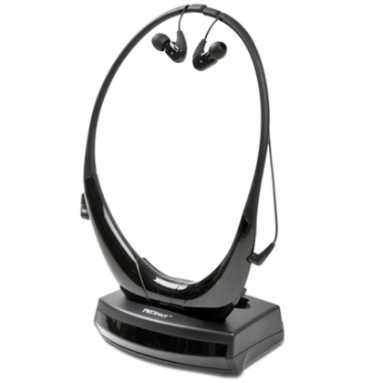
Serene
Converts any TV Audio output into an infrared light beam for wireless transmission to a receiver
Dramatically broadens the acoustic sweet spot of your living room.
Be able to clearly hear all dialogues and stereo sounds in your movie or TV program.

Slide 34
Ergonomics

Slide 35
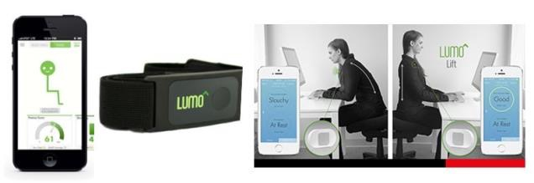
Lumo Lift
Lumo for back and head/shoulders
Sends gentle vibration alert when posture needs to be corrected

Slide 36
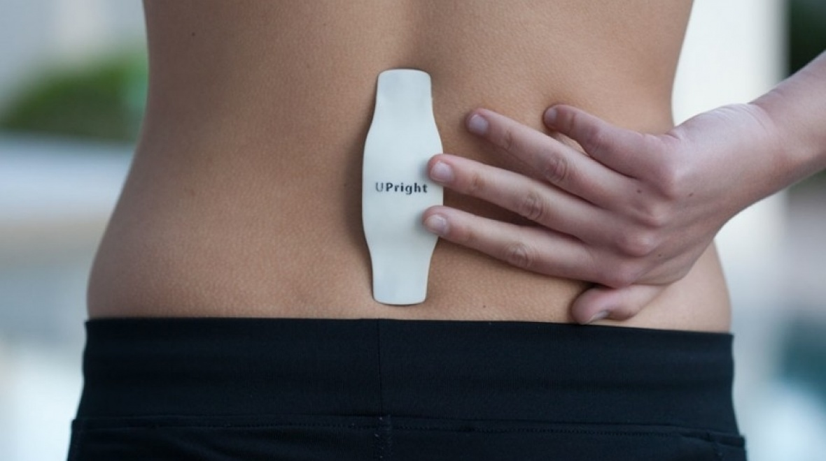
UPRIGHT- Posture Trainer
Short term training, with long term results; by training with Upright only 15 - 60 minutes a day, you will have improved core strength & muscle memory to maintain a lifelong habit of good posture.

Slide 37
Wearable Mounts

Slide 38
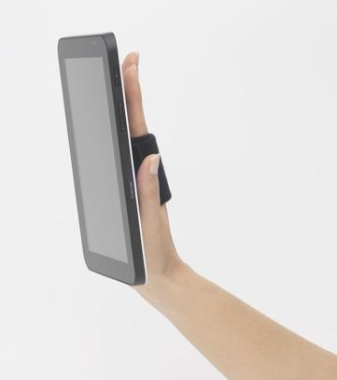
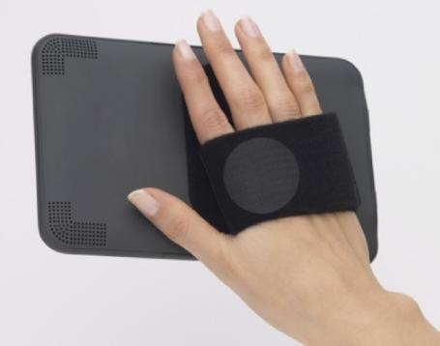
e-Handle
* Handle/grip for e-readers, tablets and iPad Minis
Safe way to hold devices with better grip, control and functionality
Rotates 360 Degrees; Easy to use; Adjustable; Detachable

Slide 39
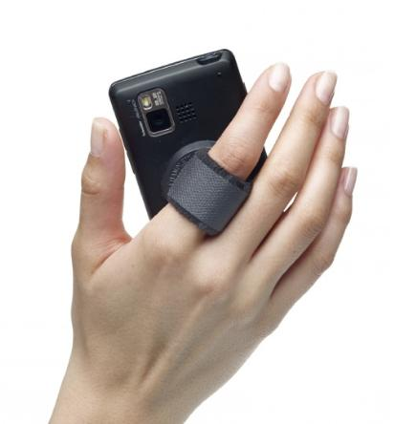
CellHandle
Wearable tech for all phones and cases
Great for larger phones
Safe way to hold and use phones
Solves dexterity issues Rotates; adjustable; detachable

Slide 40
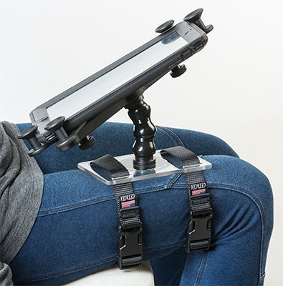
Modular hose -tabX Tablet Holder and Plate
This solution is great for situations when there is no surface to attach to hold up your tablet.
Whether lying on the sofa or sitting in a chair/wheelchair, the adjustable straps help hold it in place for hands free operation.]
Attach this tablet holder to your leg

Slide 41
Wearable GPS

Slide 42
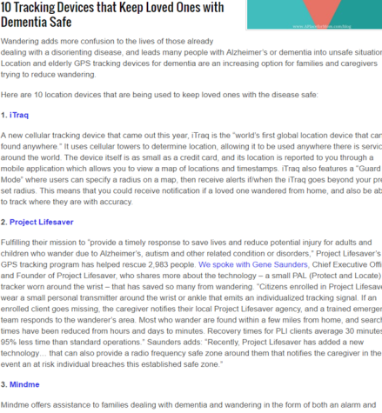
GPS Tracking Devices
Find My iPhone
Find My Friends

Slide 43
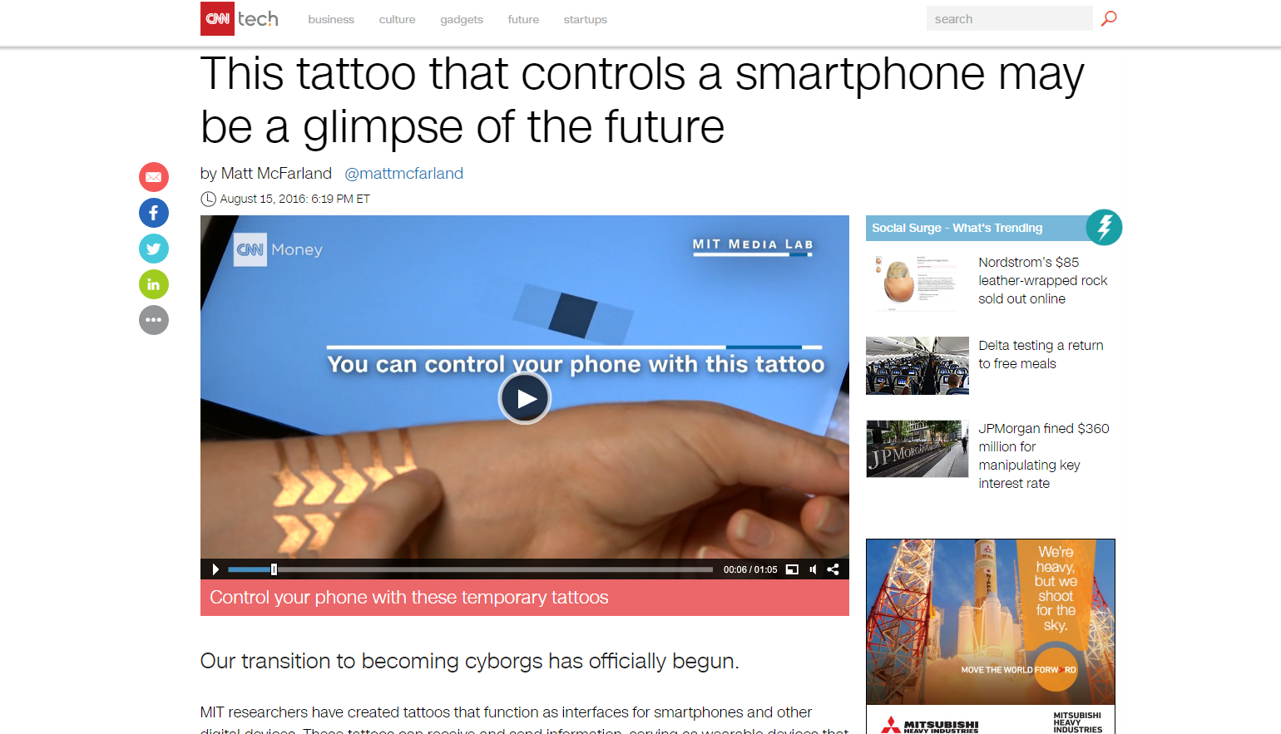
Smart Tattoos

Slide 44
Resources
https://www.statista.com/topics/1556/wearable-technology/
http://www.forbes.com/sites/paullamkin/2016/02/17/wearable-tech-market-to-be-worth-34-billion-by-2020/#18d3ae9f3fe3
http://dl.acm.org/citation.cfm?id=1358913
https://static1.squarespace.com/static/516c369de4b00b44ca2bcdce/t/527fee38e4b0217581602d6e/1384115768724/wearable-computing-the-next-big-thing-in-tech.pdf
http://www.scientific.net/AST.85.11.pdf
http://thirdwavefashion.com/2016/06/wearable-tech-for-the-disabled/
http://www.choosemuse.com/\
http://www.uprightpose.com/
http://www.scottpaultech.com/
http://www.modularhose.com/Assistive-Technology/mh-Tablet-and-Device-Solutions/130701
http://www.dudeiwantthat.com/style/jewelry/fidget-rings.asp
http://www.sereneinnovations.com/tvdirect-private-tv-listening-headset

Slide 45
My Question to You: What have You Learned today?
Notes:
45

Slide 46
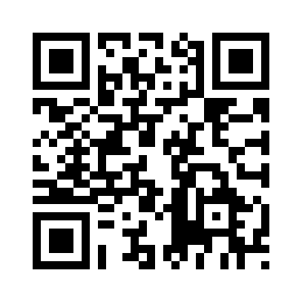
GATE Evaluation Link
http://tinyurl.com/GATEConference
Your certificate of attendance will be emailed to you upon completion of this evaluation!

Slide 47
TFL Team

Slide 48
The Tools for Life Team
Carolyn Phillips
Director, Tools for Life
Carolyn.Phillips@gatfl.gatech.edu
Sarah Endicott
Research Scientist
sarah.endicott@design.gatech.edu
Danny Housley
AT Funding & Resource Specialist
Danny.Housley@gatfl.gatech.edu
Justin Ingham
Support Specialist
jingham3@gatech.edu
Ben Jacobs
Accommodations Specialist
Ben.Jacobs@gatfl.gatech.edu
Krista Mullen
Speech Language Pathologist
krista.mullen@gatfl.gatech.edu
Samantha Peters
Support Specialist
seters37@gatfl.gatech.edu
Liz Persaud
Training and Outreach Coordinator
Liz.Persaud@gatfl.gatech.edu
Martha Rust
AT Specialist
Martha.Rust@gatfl.gatech.edu
Rachel Wilson
AT Specialist
Rachel.Wilson@gatfl.gatech.edu
Disclaimer: Produced by Tools for Life (TFL), which is a result of the Assistive Technology Act of 1998, as amended in 2004. TFL is a program of the Georgia Institute of Technology, College of Design, AMAC Accessibility Solutions and Research Center and was made possible by Grant Number H224C030009 from the Administration for Community Living. Its contents are solely the responsibility of the authors and do not necessarily represent the official views of HHS.

